Slide 1
Lecture: Memory Systems
Topics: memory scheduling, refresh, memory trends

Slide 2
Problem 3
For the following access stream, estimate the finish times for
each access with the following scheduling policies:
Req Time of arrival Open Closed Oracular
X 0 ns 40 40 40
Y 10 ns 100 100 100
X+1 100 ns 160 160 160
X+2 200 ns 220 240 220
Y+1 250 ns 310 300 290
X+3 300 ns 370 360 350
Note that X, X+1, X+2, X+3 map to the same row and Y, Y+1
map to a different row in the same bank. Ignore bus and
queuing latencies. The bank is precharged at the start.

Slide 3
Problem 4
For the following access stream, estimate the finish times for
each access with the following scheduling policies:
Req Time of arrival Open Closed Oracular
X 10 ns
X+1 15 ns
Y 100 ns
Y+1 180 ns
X+2 190 ns
Y+2 205 ns
Note that X, X+1, X+2, X+3 map to the same row and Y, Y+1
map to a different row in the same bank. Ignore bus and
queuing latencies. The bank is precharged at the start.

Slide 4
Problem 4
For the following access stream, estimate the finish times for
each access with the following scheduling policies:
Req Time of arrival Open Closed Oracular
X 10 ns 50 50 50
X+1 15 ns 70 70 70
Y 100 ns 160 140 140
Y+1 180 ns 200 220 200
X+2 190 ns 260 300 260
Y+2 205 ns 320 240 320
Note that X, X+1, X+2, X+3 map to the same row and Y, Y+1
map to a different row in the same bank. Ignore bus and
queuing latencies. The bank is precharged at the start.
** A more sophisticated oracle can do even better.

Slide 5
Address Mapping Policies
Consecutive cache lines can be placed in the same row
to boost row buffer hit rates
Consecutive cache lines can be placed in different ranks
to boost parallelism
Example address mapping policies:
row:rank:bank:channel:column:blkoffset
row:column:rank:bank:channel:blkoffset

Slide 6
Reads and Writes
A single bus is used for reads and writes
The bus direction must be reversed when switching between
reads and writes; this takes time and leads to bus idling
Hence, writes are performed in bursts; a write buffer stores
pending writes until a high water mark is reached
Writes are drained until a low water mark is reached

Slide 7
Scheduling Policies
FCFS: Issue the first read or write in the queue that is
ready for issue
First Ready - FCFS: First issue row buffer hits if you can
Close page -- early precharge
Alternate between reads and writes
Squeeze in refreshes where possible
Stall Time Fair: First issue row buffer hits, unless other
threads are being neglected

Slide 8
Error Correction
For every 64-bit word, can add an 8-bit code that can
detect two errors and correct one error; referred to as
SECDED – single error correct double error detect
A rank is now made up of 9 x8 chips, instead of 8 x8 chips
Stronger forms of error protection exist: a system is
chipkill correct if it can handle an entire DRAM chip failure

Slide 9
Refresh
Every DRAM cell must be refreshed within a 64 ms window
A row read/write automatically refreshes the row
Every refresh command performs refresh on a number of
rows, the memory rank is unavailable during that time
A refresh command is issued by the memory controller
once every 7.8us on average

Slide 10
Problem 5
Consider a single 4 GB memory rank that has 8 banks.
Each row in a bank has a capacity of 8KB. On average,
it takes 40ns to refresh one row. Assume that all 8 banks
can be refreshed in parallel. For what fraction of time will
this rank be unavailable because of refresh? How many rows
are refreshed with every refresh command?

Slide 11
Problem 5
Consider a single 4 GB memory rank that has 8 banks.
Each row in a bank has a capacity of 8KB. On average,
it takes 40ns to refresh one row. Assume that all 8 banks
can be refreshed in parallel. For what fraction of time will
this rank be unavailable because of refresh? How many rows
are refreshed with every refresh command?
The memory has 4GB/8KB = 512K rows
There are 8K refresh operations in one 64ms interval.
Each refresh operation must handle 512K/8K = 64 rows
Each bank must handle 8 rows
One refresh operation is issued every 7.8us and the
memory is unavailable for 320ns, i.e., for 4% of time.

Slide 12
Modern Memory Systems I
..
..
..
..
..
..
PROC
4 DDR4 channels
72-bit data channels
1200 MHz channels
1-2 DIMMs/channel
1-4 ranks/channel
..
..

Slide 13
Modern Memory Systems II
..
..
SMB
PROC
..
..
The link into the processor is narrow and high frequency
The Scalable Memory Buffer chip is a “router” that connects
to multiple DDR channels (wide and slow)
Boosts processor pin bandwidth and memory capacity
More expensive, high power

Slide 14
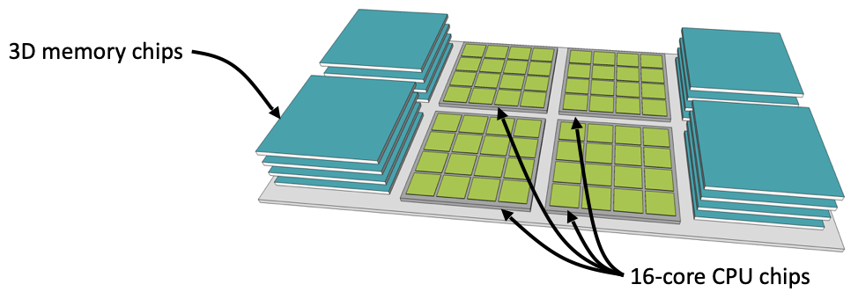
Future Memory Trends
Processor pin count is not increasing; can’t add much load
per wire; SMB-like approaches help address the capacity/bw
trade-off
High Bandwidth Memory uses wiring on a silicon substrate
(interposer) to achieve high bandwidth; uses 3D-stacked
memory chips to increase capacity on the substrate
Source: Natalie Enright Jerger, sigarch.org/blog

Slide 15
Future Memory Cells
DRAM cell scaling is expected to slow down
Emerging memory cells are expected to have better scaling
properties and eventually higher density: phase change
memory (PCM), spin torque transfer (STT-RAM), etc. – see
Intel Optane Memory
PCM: heat and cool a material with elec pulses – the rate of
heat/cool determines if the material is crystalline/amorphous;
amorphous has higher resistance (i.e., no longer using
capacitive charge to store a bit)
Advantages: non-volatile, high density, faster than Flash/disk
Disadvantages: poor write latency/energy, low endurance

