Slide 1
Lecture: Review Session
Topics: first half recap

Slide 2
Problem 3
Processor-A at 3 GHz consumes 80 W of dynamic power
and 20 W of static power. It completes a program in 20
seconds.
What is the energy consumption if I scale frequency down
by 20%?
What is the energy consumption if I scale frequency and
voltage down by 20%?

Slide 3
Problem 3
Processor-A at 3 GHz consumes 80 W of dynamic power
and 20 W of static power. It completes a program in 20
seconds.
What is the energy consumption if I scale frequency down
by 20%?
New dynamic power = 64W; New static power = 20W
New execution time = 25 secs (assuming CPU-bound)
Energy = 84 W x 25 secs = 2100 Joules
What is the energy consumption if I scale frequency and
voltage down by 20%?
New dynamic power = 41W; New static power = 16W;
New exec time = 25 secs; Energy = 1425 Joules

Slide 4
Problem 4
Consider 3 programs from a benchmark set. Assume that
system-A is the reference machine. How does the
performance of system-B compare against that of
system-C (for all 3 metrics)?
P1 P2 P3
Sys-A 5 10 20
Sys-B 6 8 18
Sys-C 7 9 14
  Sum of execution times (AM)
  Sum of weighted execution times (AM)
  Geometric mean of execution times (GM)

Slide 5
Problem 4
Consider 3 programs from a benchmark set. Assume that
system-A is the reference machine. How does the
performance of system-B compare against that of
system-C (for all 3 metrics)?
P1 P2 P3 S.E.T S.W.E.T GM
Sys-A 5 10 20 35 3 10
Sys-B 6 8 18 32 2.9 9.5
Sys-C 7 9 14 30 3 9.6
  Relative to C, B provides a speedup of 1.03 (S.W.E.T)
  or 1.01 (GM) or 0.94 (S.E.T)
  Relative to C, B reduces execution time by
  3.3% (S.W.E.T) or 1% (GM) or -6.7% (S.E.T)

Slide 6
Problem 6
My new laptop has a clock speed that is 30% higher than
the old laptop. I’m running the same binaries on both
machines. Their IPCs are listed below. I run the binaries
such that each binary gets an equal share of CPU time.
What speedup is my new laptop providing?
P1 P2 P3
Old-IPC 1.2 1.6 2.0
New-IPC 1.6 1.6 1.6

Slide 7
Problem 6
My new laptop has a clock speed that is 30% higher than
the old laptop. I’m running the same binaries on both
machines. Their IPCs are listed below. I run the binaries
such that each binary gets an equal share of CPU time.
What speedup is my new laptop providing?
P1 P2 P3 AM GM
Old-IPC 1.2 1.6 2.0 1.6 1.57
New-IPC 1.6 1.6 1.6 1.6 1.6
AM of IPCs is the right measure. Could have also used GM.
Speedup with AM would be 1.3.

Slide 8
Problem 2
An unpipelined processor takes 5 ns to work on one
instruction. It then takes 0.2 ns to latch its results into
latches. I was able to convert the circuits into 5 sequential
pipeline stages. The stages have the following lengths:
1ns; 0.6ns; 1.2ns; 1.4ns; 0.8ns. Answer the following,
assuming that there are no stalls in the pipeline.
What is the cycle time in the new processor?
What is the clock speed?
What is the IPC?
How long does it take to finish one instr?
What is the speedup from pipelining?
What is the max speedup from pipelining?

Slide 9
Problem 2
An unpipelined processor takes 5 ns to work on one
instruction. It then takes 0.2 ns to latch its results into
latches. I was able to convert the circuits into 5 sequential
pipeline stages. The stages have the following lengths:
1ns; 0.6ns; 1.2ns; 1.4ns; 0.8ns. Answer the following,
assuming that there are no stalls in the pipeline.
What is the cycle time in the new processor? 1.6ns
What is the clock speed? 625 MHz
What is the IPC? 1
How long does it take to finish one instr? 8ns
What is the speedup from pipelining? 625/192 = 3.26
What is the max speedup from pipelining? 5.2/0.2 = 26

Slide 11
Problem 8
Consider this 8-stage pipeline (RR and RW take a full cycle)
For the following pairs of instructions, how many stalls will the 2nd
instruction experience (with and without bypassing)?
  ADD R3 ← R1+R2
  ADD R5 ← R3+R4
  LD R2 ← [R1]
  ADD R4 ← R2+R3
  LD R2 ← [R1]
  SD R3 → [R2]
  LD R2 ← [R1]
  SD R2 → [R3]
IF
DE
RR
AL
AL
DM
DM
RW

Slide 12
Problem 8
Consider this 8-stage pipeline (RR and RW take a full cycle)
For the following pairs of instructions, how many stalls will the 2nd
instruction experience (with and without bypassing)?
  ADD R3 ← R1+R2
  ADD R5 ← R3+R4
  LD R2 ← [R1]
  ADD R4 ← R2+R3
  LD R2 ← [R1]
  SD R3 → [R2]
  LD R2 ← [R1]
  SD R2 → [R3]
IF
DE
RR
AL
AL
DM
DM
RW

Slide 13
Problem 8
Consider this 8-stage pipeline (RR and RW take a full cycle)
For the following pairs of instructions, how many stalls will the 2nd
instruction experience (with and without bypassing)?
  ADD R3 ← R1+R2
  ADD R5 ← R3+R4 without: 5 with: 1
  LD R2 ← [R1]
  ADD R4 ← R2+R3 without: 5 with: 3
  LD R2 ← [R1]
  SD R3 → [R2] without: 5 with: 3
  LD R2 ← [R1]
  SD R2 → [R3] without: 5 with: 1
IF
DE
RR
AL
AL
DM
DM
RW

Slide 14
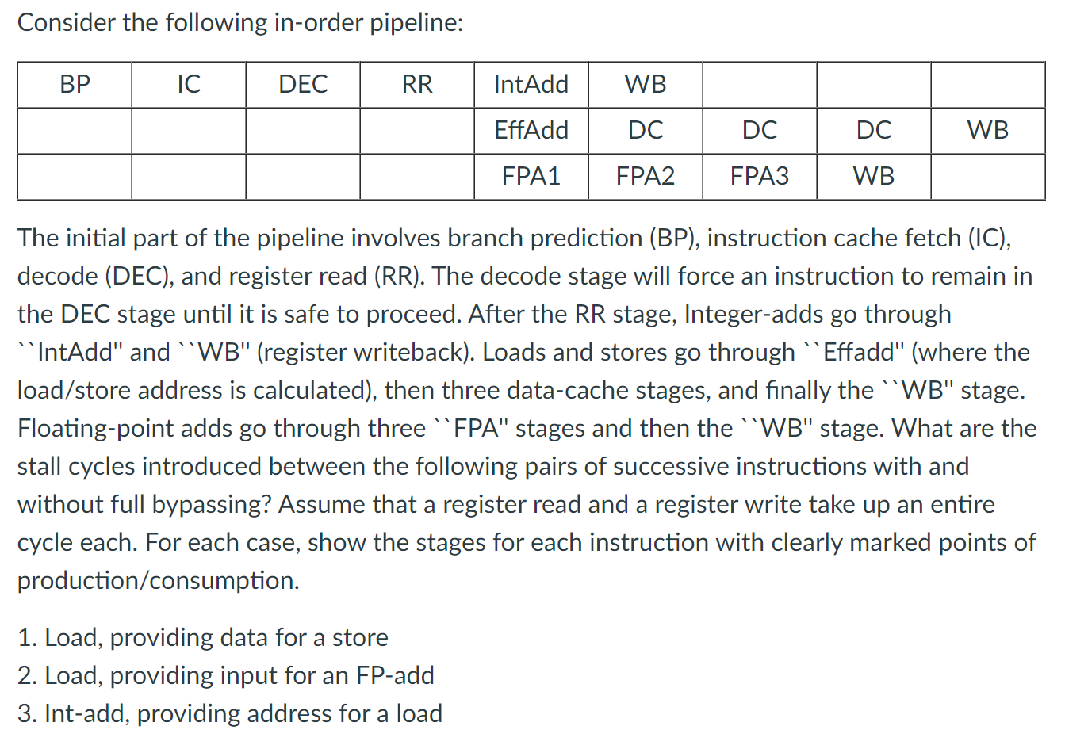

Slide 16
Problem 1
Consider a branch that is taken 80% of the time. On
average, how many stalls are introduced for this branch
for each approach below:
  Stall fetch until branch outcome is known
  Assume not-taken and squash if the branch is taken
  Assume a branch delay slot
    You can’t find anything to put in the delay slot
    An instr before the branch is put in the delay slot
    An instr from the taken side is put in the delay slot
    An instr from the not-taken side is put in the slot

Slide 17
Problem 1
Consider a branch that is taken 80% of the time. On
average, how many stalls are introduced for this branch
for each approach below:
  Stall fetch until branch outcome is known – 1
  Assume not-taken and squash if the branch is taken – 0.8
  Assume a branch delay slot
    You can’t find anything to put in the delay slot – 1
    An instr before the branch is put in the delay slot – 0
    An instr from the taken side is put in the slot – 0.2
    An instr from the not-taken side is put in the slot – 0.8

Slide 18
Problem 2b
Assume an unpipelined processor where it takes 10ns to
go through the circuits and 0.2ns for the latch overhead.
What is the throughput for 10-stage and 20-stage
pipelines? Assume that the P.O.P and P.O.C in the
unpipelined processor are separated by 3ns. Assume that
half the instructions do not introduce a data hazard and
half the instructions depend on their preceding instruction.

Slide 20
LD -> any : 1 stall
FPMUL -> any: 5 stalls
FPMUL -> ST : 4 stalls
IntALU -> BR : 1 stall
Problem 1
for (i=1000; i>0; i--)
x[i] = y[i] * s;
Source code
Loop: L.D F0, 0(R1) ; F0 = array element
MUL.D F4, F0, F2 ; multiply scalar
S.D F4, 0(R2) ; store result
DADDUI R1, R1,# -8 ; decrement address pointer
DADDUI R2, R2,#-8 ; decrement address pointer
BNE R1, R3, Loop ; branch if R1 != R3
NOP
Assembly code
How many cycles do the default and optimized schedules take?

Slide 21
LD -> any : 1 stall
FPMUL -> any: 5 stalls
FPMUL -> ST : 4 stalls
IntALU -> BR : 1 stall
Problem 1
for (i=1000; i>0; i--)
x[i] = y[i] * s;
Source code
Loop: L.D F0, 0(R1) ; F0 = array element
MUL.D F4, F0, F2 ; multiply scalar
S.D F4, 0(R2) ; store result
DADDUI R1, R1,# -8 ; decrement address pointer
DADDUI R2, R2,#-8 ; decrement address pointer
BNE R1, R3, Loop ; branch if R1 != R3
NOP
Assembly code
Unoptimized: LD 1s MUL 4s SD DA DA BNE 1s -- 12 cycles
Optimized: LD DA MUL DA 2s BNE SD -- 8 cycles
Degree 2: LD LD MUL MUL DA DA 1s SD BNE SD
Degree 3: LD LD LD MUL MUL MUL DA DA SD SD BNE SD
– 12 cyc/3 iterations

Slide 22
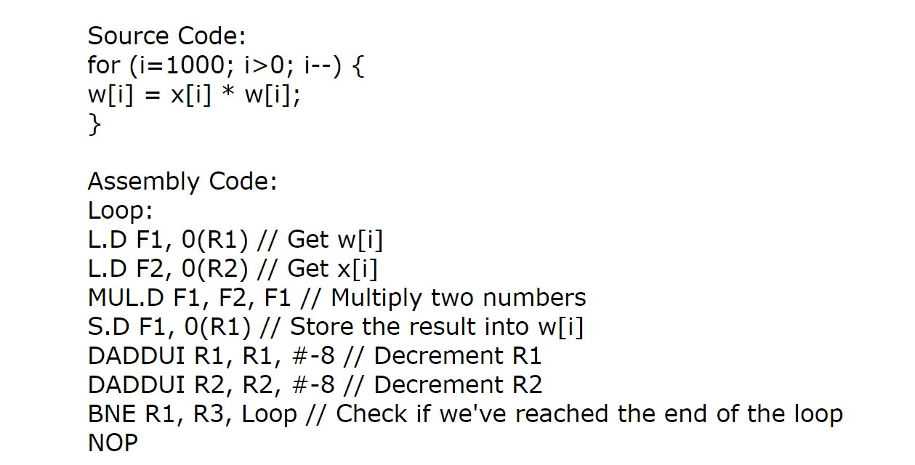

Slide 24
LD -> any : 1 stall
FPMUL -> any: 5 stalls
FPMUL -> ST : 4 stalls
IntALU -> BR : 1 stall
Problem 3
for (i=1000; i>0; i--)
x[i] = y[i] * s;
Source code
Loop: L.D F0, 0(R1) ; F0 = array element
MUL.D F4, F0, F2 ; multiply scalar
S.D F4, 0(R2) ; store result
DADDUI R1, R1,# -8 ; decrement address pointer
DADDUI R2, R2,#-8 ; decrement address pointer
BNE R1, R3, Loop ; branch if R1 != R3
NOP
Assembly code
How many unrolls does it take to avoid stalls in the superscalar pipeline?

Slide 25
LD -> any : 1 stall
FPMUL -> any: 5 stalls
FPMUL -> ST : 4 stalls
IntALU -> BR : 1 stall
Problem 3
for (i=1000; i>0; i--)
x[i] = y[i] * s;
Source code
Loop: L.D F0, 0(R1) ; F0 = array element
MUL.D F4, F0, F2 ; multiply scalar
S.D F4, 0(R2) ; store result
DADDUI R1, R1,# -8 ; decrement address pointer
DADDUI R2, R2,#-8 ; decrement address pointer
BNE R1, R3, Loop ; branch if R1 != R3
NOP
Assembly code
How many unrolls does it take to avoid stalls in the superscalar pipeline?
LD
LD
LD MUL
LD MUL
LD MUL 7 unrolls. Could also make do with 5 if we
LD MUL moved up the DADDUIs.
LD MUL
SD MUL

Slide 26
Problem 2
What is the storage requirement for a tournament predictor
that uses the following structures:
  a “selector” that has 4K entries and 2-bit counters
  a “global” predictor that XORs 14 bits of branch PC
  with 14 bits of global history and uses 3-bit counters
  a “local” predictor that uses an 8-bit index into L1, and
  produces a 12-bit index into L2 by XOR-ing branch PC
  and local history. The L2 uses 2-bit counters.

Slide 27
Problem 2
What is the storage requirement for a tournament predictor
that uses the following structures:
  a “selector” that has 4K entries and 2-bit counters
  a “global” predictor that XORs 14 bits of branch PC
  with 14 bits of global history and uses 3-bit counters
  a “local” predictor that uses an 8-bit index into L1, and
  produces a 12-bit index into L2 by XOR-ing branch PC
  and local history. The L2 uses 2-bit counters.
  Selector = 4K * 2b = 8 Kb
  Global = 3b * 2^14 = 48 Kb
  Local = (12b * 2^8) + (2b * 2^12) = 3 Kb + 8 Kb = 11 Kb
  Total = 67 Kb

Slide 28
Problem 3
For the code snippet below, estimate the steady-state
bpred accuracies for the default PC+4 prediction, the
1-bit bimodal, 2-bit bimodal, global, and local predictors.
Assume that the global/local preds use 5-bit histories.
do {
for (i=0; i<4; i++) {
increment something
}
for (j=0; j<8; j++) {
increment something
}
k++;
} while (k < some large number)

Slide 29
Problem 3
For the code snippet below, estimate the steady-state
bpred accuracies for the default PC+4 prediction, the
1-bit bimodal, 2-bit bimodal, global, and local predictors.
Assume that the global/local preds use 5-bit histories.
do {
for (i=0; i<4; i++) {
increment something
}
for (j=0; j<8; j++) {
increment something
}
k++;
} while (k < some large number)
PC+4: 2/13 = 15%
1b Bim: (2+6+1)/(4+8+1)
= 9/13 = 69%
2b Bim: (3+7+1)/13
= 11/13 = 85%
Global: (4+7+1)/13
= 12/13 = 92%
Local: (4+7+1)/13
= 12/13 = 92%

