Slide 1
Lecture: Pipelining Extensions, Static ILP
Topics: control hazards, multi-cycle instructions,
pipelining equations, loops intro

Slide 2
Problem 7
For the 5-stage pipeline (RR and RW take half a cycle)
For the following pairs of instructions, how many stalls will the 2nd
instruction experience (with and without bypassing)?
  ADD R3 ← R1+R2
  ADD R5 ← R3+R4
  LD R2 ← [R1]
  ADD R4 ← R2+R3
  LD R2 ← [R1]
  SD R3 → [R2]
  LD R2 ← [R1]
  SD R2 → [R3]
IF
D/RR
AL
DM
RW

Slide 3
Problem 7
For the 5-stage pipeline (RR and RW take half a cycle)
For the following pairs of instructions, how many stalls will the 2nd
instruction experience (with and without bypassing)?
  ADD R3 ← R1+R2
  ADD R5 ← R3+R4 without: 2 with: 0
  LD R2 ← [R1]
  ADD R4 ← R2+R3 without: 2 with: 1
  LD R2 ← [R1]
  SD R3 → [R2] without: 2 with: 1
  LD R2 ← [R1]
  SD R2 → [R3] without: 2 with: 0
IF
D/RR
AL
DM
RW

Slide 4
Summary
For the 5-stage pipeline, bypassing can eliminate delays
between the following example pairs of instructions:
add/sub R1, R2, R3
add/sub/lw/sw R4, R1, R5
lw R1, 8(R2)
sw R1, 4(R3)
The following pairs of instructions will have intermediate
stalls:
lw R1, 8(R2)
add/sub/lw R3, R1, R4 or sw R3, 8(R1)
fmul F1, F2, F3
fadd F5, F1, F4

Slide 5
Problem 8
Consider this 8-stage pipeline (RR and RW take a full cycle)
For the following pairs of instructions, how many stalls will the 2nd
instruction experience (with and without bypassing)?
  ADD R3 ← R1+R2
  ADD R5 ← R3+R4
  LD R2 ← [R1]
  ADD R4 ← R2+R3
  LD R2 ← [R1]
  SD R3 → [R2]
  LD R2 ← [R1]
  SD R2 → [R3]
IF
DE
RR
AL
AL
DM
DM
RW

Slide 6
Problem 8
Consider this 8-stage pipeline (RR and RW take a full cycle)
For the following pairs of instructions, how many stalls will the 2nd
instruction experience (with and without bypassing)?
  ADD R3 ← R1+R2
  ADD R5 ← R3+R4 without: 5 with: 1
  LD R2 ← [R1]
  ADD R4 ← R2+R3 without: 5 with: 3
  LD R2 ← [R1]
  SD R3 → [R2] without: 5 with: 3
  LD R2 ← [R1]
  SD R2 → [R3] without: 5 with: 1
IF
DE
RR
AL
AL
DM
DM
RW

Slide 7
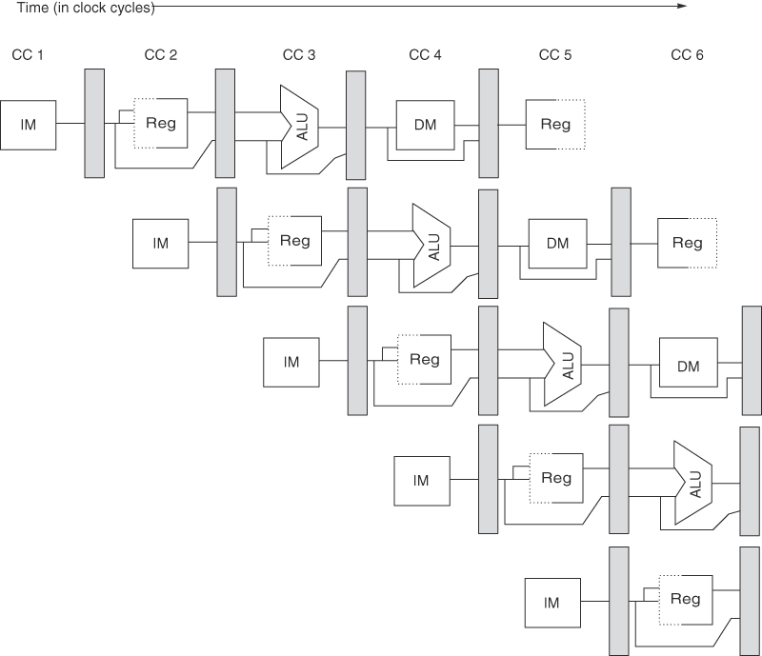
Stalls from Control Hazards
PC/L1
L2
L3
L4
L5
Source: H&P textbook

Slide 8
Control Hazards
Simple techniques to handle control hazard stalls:
  for every branch, introduce a stall cycle (note: every
  6th instruction is a branch on average!)
  assume the branch is not taken and start fetching the
  next instruction – if the branch is taken, need hardware
  to cancel the effect of the wrong-path instructions
  predict the next PC and fetch that instr – if the prediction
  is wrong, cancel the effect of the wrong-path instructions
  fetch the next instruction (branch delay slot) and
  execute it anyway – if the instruction turns out to be
  on the correct path, useful work was done – if the
  instruction turns out to be on the wrong path,
  hopefully program state is not lost

Slide 9
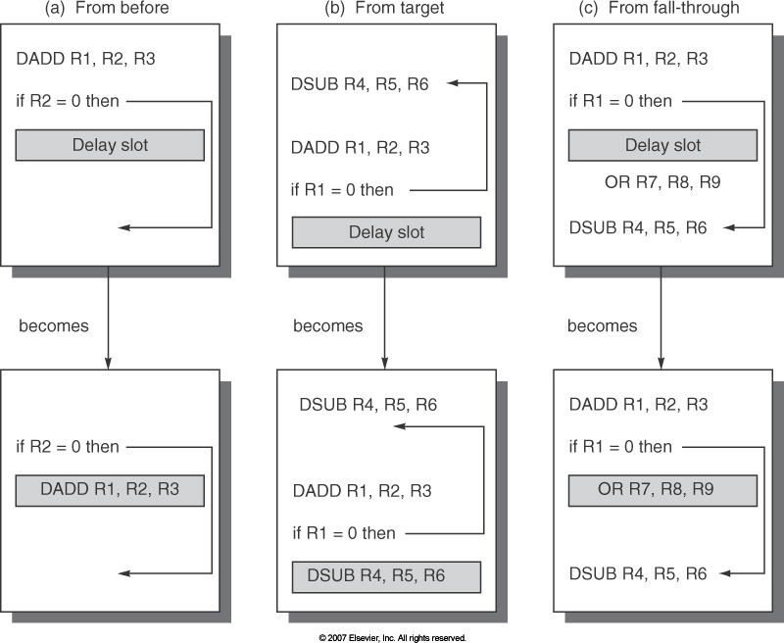
Branch Delay Slots

Slide 10
Problem 1
Consider a branch that is taken 80% of the time. On
average, how many stalls are introduced for this branch
for each approach below:
  Stall fetch until branch outcome is known
  Assume not-taken and squash if the branch is taken
  Assume a branch delay slot
    You can’t find anything to put in the delay slot
    An instr before the branch is put in the delay slot
    An instr from the taken side is put in the delay slot
    An instr from the not-taken side is put in the slot

Slide 11
Problem 1
Consider a branch that is taken 80% of the time. On
average, how many stalls are introduced for this branch
for each approach below:
  Stall fetch until branch outcome is known – 1
  Assume not-taken and squash if the branch is taken – 0.8
  Assume a branch delay slot
    You can’t find anything to put in the delay slot – 1
    An instr before the branch is put in the delay slot – 0
    An instr from the taken side is put in the slot – 0.2
    An instr from the not-taken side is put in the slot – 0.8

Slide 12
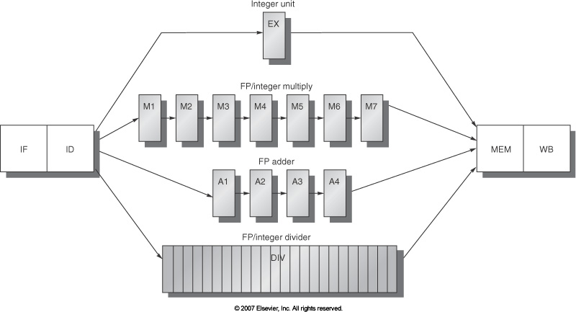
Multicycle Instructions

Slide 13
Effects of Multicycle Instructions
Potentially multiple writes to the register file in a cycle
Frequent RAW hazards
WAW hazards (WAR hazards not possible)
Imprecise exceptions because of o-o-o instr completion
Note: Can also increase the “width” of the processor: handle
multiple instructions at the same time: for example, fetch
two instructions, read registers for both, execute both, etc.

Slide 14
Precise Exceptions
On an exception:
  must save PC of instruction where program must resume
  all instructions after that PC that might be in the pipeline
  must be converted to NOPs (other instructions continue
  to execute and may raise exceptions of their own)
  temporary program state not in memory (in other words,
  registers) has to be stored in memory
  potential problems if a later instruction has already
  modified memory or registers
A processor that fulfils all the above conditions is said to
provide precise exceptions (useful for debugging and of
course, correctness)

Slide 15
Dealing with these Effects
Multiple writes to the register file: increase the number of
ports, stall one of the writers during ID, stall one of the
writers during WB (the stall will propagate)
WAW hazards: detect the hazard during ID and stall the
later instruction
Imprecise exceptions: buffer the results if they complete
early or save more pipeline state so that you can return to
exactly the same state that you left at

Slide 16
Slowdowns from Stalls
Perfect pipelining with no hazards → an instruction
completes every cycle (total cycles ~ num instructions)
→ speedup = increase in clock speed = num pipeline stages
With hazards and stalls, some cycles (= stall time) go by
during which no instruction completes, and then the stalled
instruction completes
Total cycles = number of instructions + stall cycles
Slowdown because of stalls = 1/ (1 + stall cycles per instr)

Slide 17
Pipelining Limits
Gap between indep instrs: T + Tovh
Gap between dep instrs: T + Tovh
A
B
C
Gap between indep instrs:
T/3 + Tovh
Gap between dep instrs:
T + 3Tovh
A
B
C
A
B
C
D
E
F
Gap between indep instrs:
T/6 + Tovh
Gap between dep instrs:
T + 6Tovh
A
B
C
D
E
F
Assume that there is a dependence where the final result of the
first instruction is required before starting the second instruction

Slide 18
Problem 2
Assume an unpipelined processor where it takes 5ns to
go through the circuits and 0.1ns for the latch overhead.
What is the throughput for 20-stage and 40-stage
pipelines? Assume that the P.O.P and P.O.C in the
unpipelined processor are separated by 2ns. Assume that
half the instructions do not introduce a data hazard and
half the instructions depend on their preceding instruction.

Slide 19
Problem 2
Assume an unpipelined processor where it takes 5ns to
go through the circuits and 0.1ns for the latch overhead.
What is the throughput for 1-stage, 20-stage and 50-stage
pipelines? Assume that the P.O.P and P.O.C in the
unpipelined processor are separated by 2ns. Assume that
half the instructions do not introduce a data hazard and
half the instructions depend on their preceding instruction.
  1-stage: 1 instr every 5.1ns
  20-stage: first instr takes 0.35ns, the second takes 2.8ns
  50-stage: first instr takes 0.2ns, the second takes 4ns
  Throughputs: 0.20 BIPS, 0.63 BIPS, and 0.48 BIPS

