Slide 1
Lecture: Pipelining Basics
Topics: Basic pipelining implementation, performance equations
Reminder: HW1 due Thursday 11:59pm

Slide 2
Performance Metrics Recap
Performance summaries: AM of weighted exec times, GM
AM of IPCs, HM of IPCs (AM of CPIs), GM of IPCs
Speedup (ratio), performance improvement (ratio – 1)
CPU time = cycle time x CPI x #instructions

Slide 3
Building a Car
Unpipelined
Start and finish a job before moving to the next
Jobs
Time

Slide 4
The Assembly Line
Pipelined
Break the job into smaller stages
A
B
C
A
B
C
A
B
C
Jobs
A
B
C
Time

Slide 5
Clocks and Latches
Stage 1
Stage 2

Slide 6
Clocks and Latches
Stage 1
L
Stage 2
L
Clk

Slide 7
Some Equations
Unpipelined: time to execute one instruction = T + Tovh
For an N-stage pipeline, time per stage = T/N + Tovh
Total time per instruction = N (T/N + Tovh) = T + N Tovh
Clock cycle time = T/N + Tovh
Clock speed = 1 / (T/N + Tovh)
Ideal speedup = (T + Tovh) / (T/N + Tovh)
Cycles to complete one instruction = N
Average CPI (cycles per instr) = 1

Slide 8
Problem 1
An unpipelined processor takes 5 ns to work on one
instruction. It then takes 0.2 ns to latch its results into
latches. I was able to convert the circuits into 5 equal
sequential pipeline stages. Answer the following, assuming
that there are no stalls in the pipeline.
What are the cycle times in the two processors?
What are the clock speeds?
What are the IPCs?
How long does it take to finish one instr?
What is the speedup from pipelining?

Slide 9
Problem 1
An unpipelined processor takes 5 ns to work on one
instruction. It then takes 0.2 ns to latch its results into
latches. I was able to convert the circuits into 5 equal
sequential pipeline stages. Answer the following, assuming
that there are no stalls in the pipeline.
What are the cycle times in the two processors?
5.2ns and 1.2ns
What are the clock speeds? 192 MHz and 833 MHz
What are the IPCs? 1 and 1
How long does it take to finish one instr? 5.2ns and 6ns
What is the speedup from pipelining? 833/192 = 4.34

Slide 10
Problem 2
An unpipelined processor takes 5 ns to work on one
instruction. It then takes 0.2 ns to latch its results into
latches. I was able to convert the circuits into 5 sequential
pipeline stages. The stages have the following lengths:
1ns; 0.6ns; 1.2ns; 1.4ns; 0.8ns. Answer the following,
assuming that there are no stalls in the pipeline.
What is the cycle time in the new processor?
What is the clock speed?
What is the IPC?
How long does it take to finish one instr?
What is the speedup from pipelining?
What is the max speedup from pipelining?

Slide 11
Problem 2
An unpipelined processor takes 5 ns to work on one
instruction. It then takes 0.2 ns to latch its results into
latches. I was able to convert the circuits into 5 sequential
pipeline stages. The stages have the following lengths:
1ns; 0.6ns; 1.2ns; 1.4ns; 0.8ns. Answer the following,
assuming that there are no stalls in the pipeline.
What is the cycle time in the new processor? 1.6ns
What is the clock speed? 625 MHz
What is the IPC? 1
How long does it take to finish one instr? 8ns
What is the speedup from pipelining? 625/192 = 3.26
What is the max speedup from pipelining? 5.2/0.2 = 26

Slide 12
Pipelining Curves

Slide 13
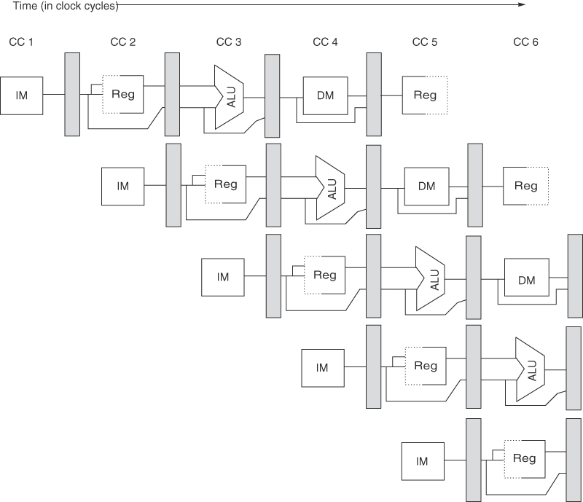
A 5-Stage Pipeline
Source: H&P textbook

Slide 14
A 5-Stage Pipeline
Use the PC to access the I-cache and increment PC by 4

Slide 15
A 5-Stage Pipeline
Read registers, compare registers, compute branch target; for now, assume
branches take 2 cyc (there is enough work that branches can easily take more)

Slide 16
A 5-Stage Pipeline
ALU computation, effective address computation for load/store

Slide 17
A 5-Stage Pipeline
Memory access to/from data cache, stores finish in 4 cycles

Slide 18
A 5-Stage Pipeline
Write result of ALU computation or load into register file

