Slide 1
Lecture 7: Examples, MARS
Today’s topics:
  More examples
  MARS intro

Slide 2
Example 2 (pg. 101)
int fact (int n)
{
if (n < 1) return (1);
else return (n * fact(n-1));
}
fact:
slti $t0, $a0, 1
beq $t0, $zero, L1
addi $v0, $zero, 1
jr $ra
L1:
addi $sp, $sp, -8
sw $ra, 4($sp)
sw $a0, 0($sp)
addi $a0, $a0, -1
jal fact
lw $a0, 0($sp)
lw $ra, 4($sp)
addi $sp, $sp, 8
mul $v0, $a0, $v0
jr $ra
Notes:
The caller saves $a0 and $ra
in its stack space.
Temp register $t0 is never saved.

Slide 3
slti
if ($a0 < 1)
then …
else …
slti $t0, $a0, 1 # if $a0 < 1, set $t0 = 1, else $t0 = 0
beq $t0, $zero, else
then:
…
else:
Easier to implement with pseudo-instructions like blt, bge.

Slide 4
Dealing with Characters
Instructions are also provided to deal with byte-sized
and half-word quantities: lb (load-byte), sb, lh, sh
These data types are most useful when dealing with
characters, pixel values, etc.
C employs ASCII formats to represent characters – each
character is represented with 8 bits and a string ends in
the null character (corresponding to the 8-bit number 0);
A is 65, a is 97

Slide 5
Example 3 (pg. 108)
Convert to assembly:
void strcpy (char x[], char y[])
{
int i;
i=0;
while ((x[i] = y[i]) != `\0’)
i += 1;
}
strcpy:
addi $sp, $sp, -4
sw $s0, 0($sp)
add $s0, $zero, $zero
L1: add $t1, $s0, $a1
lb $t2, 0($t1)
add $t3, $s0, $a0
sb $t2, 0($t3)
beq $t2, $zero, L2
addi $s0, $s0, 1
j L1
L2: lw $s0, 0($sp)
addi $sp, $sp, 4
jr $ra
Notes:
Temp registers not saved.

Slide 6
Saving Conventions
Caller saved: Temp registers $t0-$t9 (the callee won’t
bother saving these, so save them if you care), $ra (it’s
about to get over-written), $a0-$a3 (so you can put in
new arguments), $fp (if being used by the caller)
Callee saved: $s0-$s7 (these typically contain “valuable”
data)
Read the Notes on the class webpage on this topic

Slide 7
Large Constants
Immediate instructions can only specify 16-bit constants
The lui instruction is used to store a 16-bit constant into
the upper 16 bits of a register… combine this with an
OR instruction to specify a 32-bit constant
The destination PC-address in a conditional branch is
specified as a 16-bit constant, relative to the current PC
A jump (j) instruction can specify a 26-bit constant; if more
bits are required, the jump-register (jr) instruction is used
See green sheet!

Slide 8
Starting a Program
C Program
x.c
Compiler
Assembly language program
x.s
Assembler
x.o
x.a, x.so
Object: machine language module
Object: library routine (machine language)
Linker
Executable: machine language program
a.out
Loader
Memory

Slide 9
Role of Assembler
Convert pseudo-instructions into actual hardware
instructions – pseudo-instrs make it easier to program
in assembly – examples: “move”, “blt”, 32-bit immediate
operands, labels, etc.
Convert assembly instrs into machine instrs – a separate
object file (x.o) is created for each C file (x.c) – compute
the actual values for instruction labels – maintain info
on external references and debugging information

Slide 10
Role of Linker
Stitches different object files into a single executable
  patch internal and external references
  determine addresses of data and instruction labels
  organize code and data modules in memory
Some libraries (DLLs) are dynamically linked – the
executable points to dummy routines – these dummy
routines call the dynamic linker-loader so they can
update the executable to jump to the correct routine

Slide 11
Full Example – Sort in C (pg. 133)
void sort (int v[ ], int n)
{
int i, j;
for (i=0; i<n; i+=1) {
for (j=i-1; j>=0 && v[j] > v[j+1]; j-=1) {
swap (v,j);
}
}
}
void swap (int v[ ], int k)
{
int temp;
temp = v[k];
v[k] = v[k+1];
v[k+1] = temp;
}
Allocate registers to program variables
Produce code for the program body
Preserve registers across procedure invocations

Slide 12
The swap Procedure
Register allocation: $a0 and $a1 for the two arguments, $t0 for the
temp variable – no need for saves and restores as we’re not using
$s0-$s7 and this is a leaf procedure (won’t need to re-use $a0 and $a1)
swap: sll $t1, $a1, 2
add $t1, $a0, $t1
lw $t0, 0($t1)
lw $t2, 4($t1)
sw $t2, 0($t1)
sw $t0, 4($t1)
jr $ra
void swap (int v[], int k)
{
int temp;
temp = v[k];
v[k] = v[k+1];
v[k+1] = temp;
}

Slide 13
The sort Procedure
Register allocation: arguments v and n use $a0 and $a1, i and j use
$s0 and $s1; must save $a0 and $a1 before calling the leaf procedure
The outer for loop looks like this: (note the use of pseudo-instrs)
move $s0, $zero # initialize the loop
loopbody1: bge $s0, $a1, exit1 # will eventually use slt and beq
… body of inner loop …
addi $s0, $s0, 1
j loopbody1
exit1:
for (i=0; i<n; i+=1) {
for (j=i-1; j>=0 && v[j] > v[j+1]; j-=1) {
swap (v,j);
}
}

Slide 14
The sort Procedure
The inner for loop looks like this:
addi $s1, $s0, -1 # initialize the loop
loopbody2: blt $s1, $zero, exit2 # will eventually use slt and beq
sll $t1, $s1, 2
add $t2, $a0, $t1
lw $t3, 0($t2)
lw $t4, 4($t2)
ble $t3, $t4, exit2
… body of inner loop …
addi $s1, $s1, -1
j loopbody2
exit2:
for (i=0; i<n; i+=1) {
for (j=i-1; j>=0 && v[j] > v[j+1]; j-=1) {
swap (v,j);
}
}

Slide 15
Saves and Restores
Since we repeatedly call “swap” with $a0 and $a1, we begin
“sort” by copying its arguments into $s2 and $s3 – must update
the rest of the code in “sort” to use $s2 and $s3 instead of
$a0 and $a1
Must save $ra at the start of “sort” because it will get
over-written when we call “swap”
Must also save $s0-$s3 so we don’t overwrite something that
belongs to the procedure that called “sort”

Slide 16
Saves and Restores
sort: addi $sp, $sp, -20
sw $ra, 16($sp)
sw $s3, 12($sp)
sw $s2, 8($sp)
sw $s1, 4($sp)
sw $s0, 0($sp)
move $s2, $a0
move $s3, $a1
…
move $a0, $s2 # the inner loop body starts here
move $a1, $s1
jal swap
…
exit1: lw $s0, 0($sp)
…
addi $sp, $sp, 20
jr $ra
9 lines of C code → 35 lines of assembly

Slide 17
MARS
MARS is a simulator that reads in an assembly program
and models its behavior on a MIPS processor
Note that a “MIPS add instruction” will eventually be
converted to an add instruction for the host computer’s
architecture – this translation happens under the hood
To simplify the programmer’s task, it accepts
pseudo-instructions, large constants, constants in
decimal/hex formats, labels, etc.
The simulator allows us to inspect register/memory
values to confirm that our program is behaving correctly

Slide 18
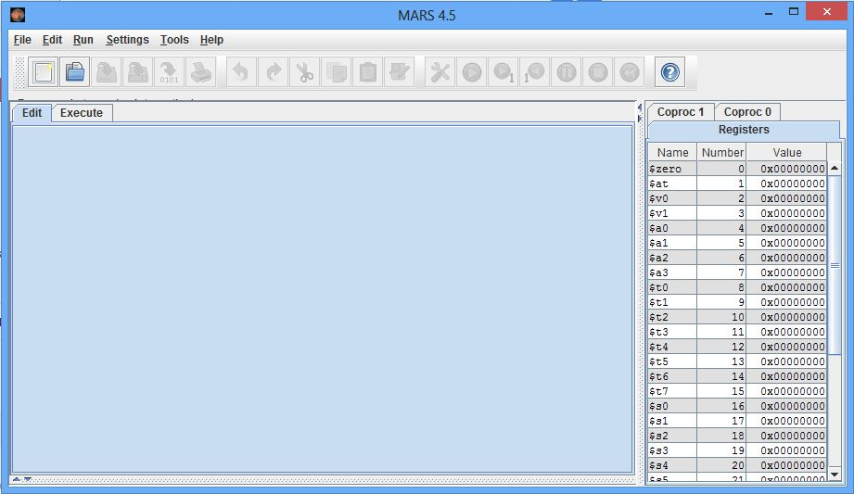
MARS Intro
Directives, labels, global pointers, system calls

Slide 19


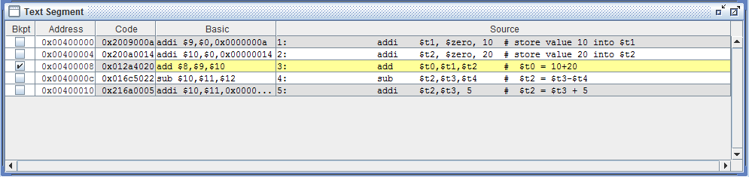
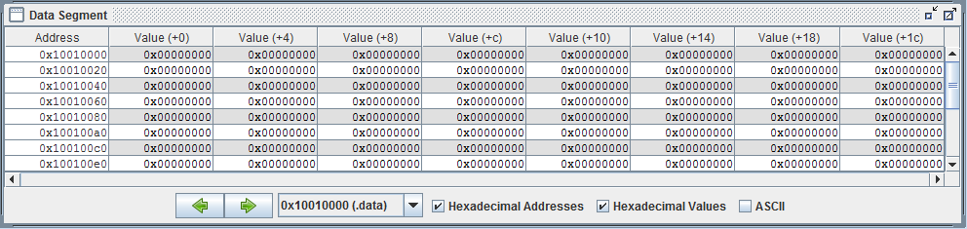
MARS Intro

Slide 20
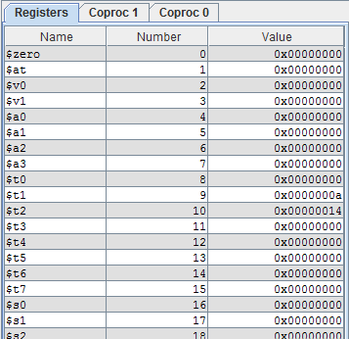
MARS Intro
Read the google doc on the class webpage for details!

Slide 21
Example Print Routine
.data
str: .asciiz “the answer is ”
.text
li $v0, 4 # load immediate; 4 is the code for print_string
la $a0, str # the print_string syscall expects the string
# address as the argument; la is the instruction
# to load the address of the operand (str)
syscall # MARS will now invoke syscall-4
li $v0, 1 # syscall-1 corresponds to print_int
li $a0, 5 # print_int expects the integer as its argument
syscall # MARS will now invoke syscall-1

Slide 22
Example
Write an assembly program to prompt the user for two
numbers and print the sum of the two numbers

Slide 23
Example
.data
str1: .asciiz “Enter 2 numbers:”
.text str2: .asciiz “The sum is ”
li $v0, 4
la $a0, str1
syscall
li $v0, 5
syscall
add $t0, $v0, $zero
li $v0, 5
syscall
add $t1, $v0, $zero
li $v0, 4
la $a0, str2
syscall
li $v0, 1
add $a0, $t1, $t0
syscall

