Slide 1
Transparent Checkpoint of Closed Distributed Systems in Emulab
Anton Burtsev, Prashanth Radhakrishnan,
Mike Hibler, and Jay Lepreau
University of Utah, School of Computing
Notes:
Thank you <>, good morning everyone. This is the talk about extending Emulab with the more control over execution of a distributed system it runs. We implement transparent checkpoint of a computer network -- transparent in a way that Emulab experiment never learns it is checkpointed (of course unless it really tries to check this). This way we can control execution of the network at a fine granularity, while ensuring fidelity of performance results based on transparency.
=================================================
ToDo: Closed nature of the system… how well this should be explained
ToDo: experiments about delays
ToDo: animations:
- Emulab
- Checkpoint essentials +
- Lamport checkpoint
Challenges
- Atomicity of checkpoint +
- Synchronization
- Delay bandwidth packets
Solution
- Temporal firewall
- Delay nodes checkpoint
- Disk

Slide 2
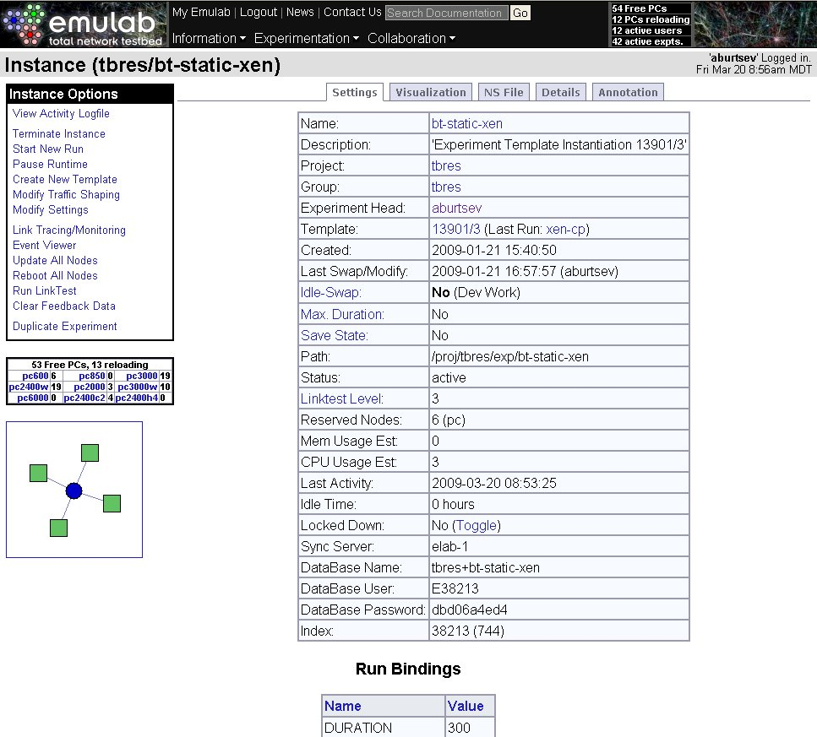
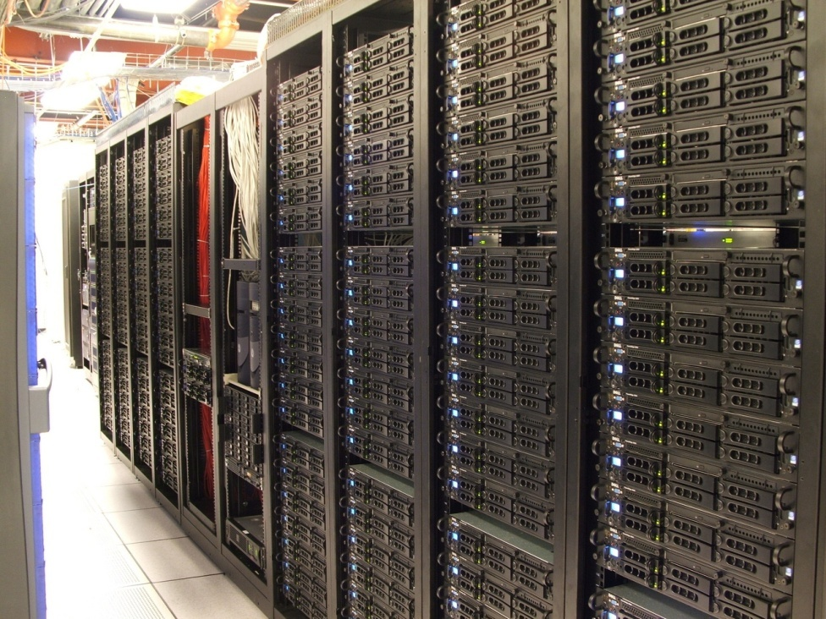
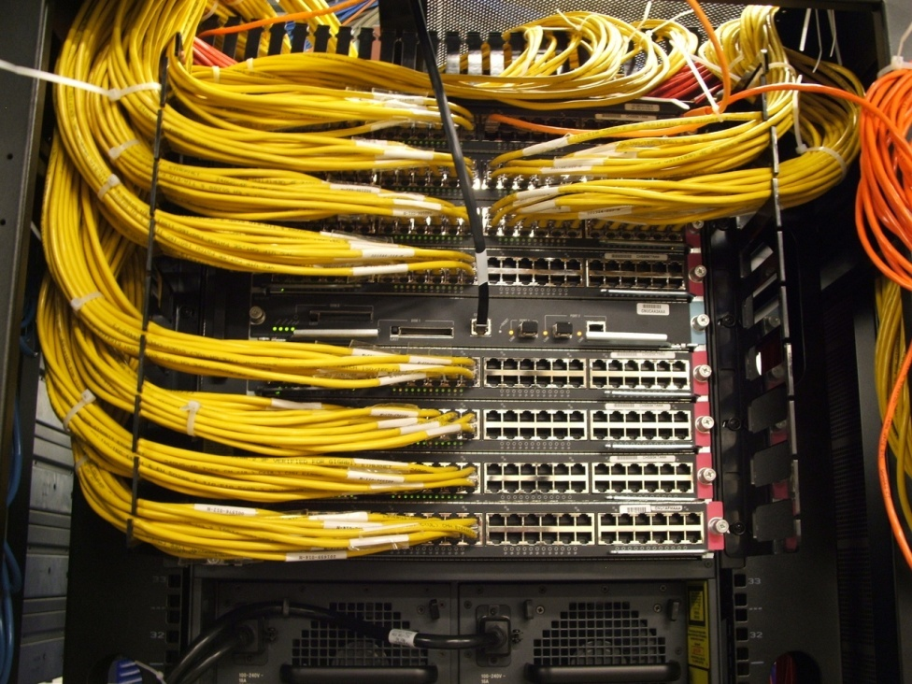
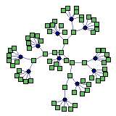
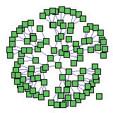
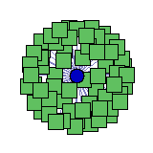
Emulab
Public testbed for network experimentation
Complex networking experiments within minutes
Notes:
For those of you who don’t know, Emulab is a piece of art. It is no question. Emulab is a public testbed for network experimentation. It is
- 300 machines in a single room
- Powerful switching infrastructure
- Control interface to configure and run experiments,
And as a result Emulab is a tool to conduct complex networking experiments within minutes.
=====================================
300 machines <A picture of a testbed>
switching infrastructure <switches?>
interface to configure and run experiments <A picture of an interface>
Complex networking experiments within minutes <Substituted by a complex experiment shot from the web,>
And by a logical view from the paper? => most probably next slide

Slide 3
Emulab — precise research tool
Realism:
Real dedicated hardware
Machines and networks
Real operating systems
Freedom to configure any component of the software stack
Meaningful real-world results
Control:
Closed system
Controlled external dependencies and side effects
Control interface
Repeatable, directed experimentation
Notes:
To be a precise research tool, Emulab is built around two main principles realism and control of experimentation.
…. As a result Emulab ensures that experimental results are similar to like production environments to a fine level of detail.
Control is the way to extract information from your experiments, i.e. obtain meaningful results … Control provides a way to conduct repeatable, directed experimentation
===============================================
Emulab is design to be a precise research tool, i.e. it not only provides assistance in experimentation making it faster, it ensures that experimental results are similar to like production environments to a fine level of detail.
Emulab is built around two main principles realism and control of experimentation
Realism
Control interface (I removed this bullet, bring back?):
Control interface to guide experimentation
<… something has to improve this argument>

Slide 4
Goal: more control over execution
Stateful swap-out
Demand for physical resources exceeds capacity
Preemptive experiment scheduling
Long-running
Large-scale experiments
No loss of experiment state
Time-travel
Replay experiments
Deterministically or non-deterministically
Debugging and analysis aid
Notes:
We want more control over experiment execution. At the moment Emulab allows you to set up initial conditions and re-launch the experiment, however after that the ball is rolling, you can’t suspend, preempt, rollback or replay the execution.
Two specific forms of control motivate this work: stateful swapout and time-travel.
The more control you have the more information you can extract out of experiment.
There is always a tension between control and realism – the more control you have the more information you can extract out of experiment, but control often hurts realism – full simulation allows to stop experiment at any point of time, but it’s not clear how meaningful your results are comparing to a real hardware.
We want more control over execution
To conduct more meaningful experiments
SS
Demand for physical resources exceeds capacity
Primitive form of time-sharing
- TT
- Time-travel in Emulab allows a user to preserve the execution of an experiment and later, if desired, play it forward from any point in time that the experimenter deems interesting.
- For example, if a feature begins to develop only after a certain period of time or develops randomly within the run, time-travel would allow continuation of the experiment around the points of interest.
Similarly, if a phenomenon is observed mid-way through an experiment run and the user wants to understand the circumstances under which it occurs, it is possible to restart the run from a point just before the appearance of the phenomenon.
The user could revisit the point of appearance many times, each time with a different
set of environmental conditions.
- Here it’s not clear how both rely on transparency of distr. checkpoint? True?

Slide 5
Challenge
Both controls should preserve fidelity of experimentation
Both rely on transparency of distributed checkpoint

Slide 6
Transparent checkpoint
Traditionally, semantic transparency:
Checkpointed execution is one of the possible correct executions
What if we want to preserve performance correctness?
Checkpointed execution is one of the correct executions closest to a non-checkpointed run
Preserve measurable parameters of the system
CPU allocation
Elapsed time
Disk throughput
Network delay and bandwidth
Notes:
What do we mean by transparency of the checkpoint? Traditionally, the checkpoint preserves semantic transparency, in other words, checkpointed execution of a system is one of the possible non-faulty executions, again in other words you don’t see functional anomalies.
For us however, semantic correctness is not enough, …..
We want to preserve performance correctness, in other words we want checkpointed execution to be as much close as possible to a non-checkpointed normal run. We want to preserve all measurable parameters of the system.

Slide 7
Traditional view
Local case
Transparency = smallest possible downtime
Several milliseconds [Remus]
Background work
Harms realism
Distributed case
Lamport checkpoint
Provides consistency
Packet delays, timeouts, traffic bursts, replay buffer overflows
Notes:
OK, what is wrong with traditional checkpoints and why they are not transparent enough? Traditionally, in local case checkpoint techniques are aimed on optimizing the checkpoint downtime. And it can be reduced to an order of several milliseconds. The price for that is however the background work needed to pre-copy or copy-on-write the state of a checkpointed system. Essentially, pusshing this to an extream your can say that the system never leaves the checkpoint, blurring the edge between the checkpoint and logging. It’s perfectly fine for many setups. We however believe it hurts realism too much.
In a distributed case checkpoint traditionally aimed to preserve consistency. To avoid anomalies and ensure that messages between the nodes never cross the checkpoint edge, the checkpoint algorithm logs and replays all messages being in flight at the moment of checkpoint. Turns out that the message replay is a very dangerous approach easily leading to packet delays, timeouts, traffic bursts and buffer overflows caused by unexpected packets coming from the replay logs.
================================================
Lamport checkpoint – non-coordinated consistent distributed checkpoint
Background work
Pre-copy and copy-on-write checkpoint state
Almost logging

Slide 8
Main insight
Conceal checkpoint from the system under test
But still stay on the real hardware as much as possible
“Instantly” freeze the system
Time and execution
Ensure atomicity of checkpoint
Single non-divisible action
Conceal checkpoint by time virtualization
Notes:
- Here I guess I can include this spectrum slide --

Slide 9
Contributions
Transparency of distributed checkpoint
Local atomicity
Temporal firewall
Execution control mechanisms for Emulab
Stateful swap-out
Time-travel
Branching storage
Notes:
Here I guess I can include this spectrum slide –
Thin layer of execution control inside Linux kernel

Slide 10
Challenges and implementation

Slide 11
Checkpoint essentials
State encapsulation
Suspend execution
Save running state of the system
Virtualization layer
Notes:
TODO:
turn the jobs green

Slide 12
Checkpoint essentials
State encapsulation
Suspend execution
Save running state of the system
Virtualization layer
Suspends the system
Saves its state
Saves in-flight state
Disconnects/reconnects to the hardware

Slide 13
First challenge: atomicity
Permanent encapsulation is harmful
Too slow
Some state is shared
Encapsulated upon checkpoint
Externally to VM
Full memory virtualization
Needs declarative description of shared state
Internally to VM
Breaks atomicity
?
Notes:
This is very surprising that VM checkpoint is not atomic
An atomic operation in computer science refers to a set of operations that can be combined so that they appear to the rest of the system to be a single operation with only two possible outcomes: success or failure.

Slide 14
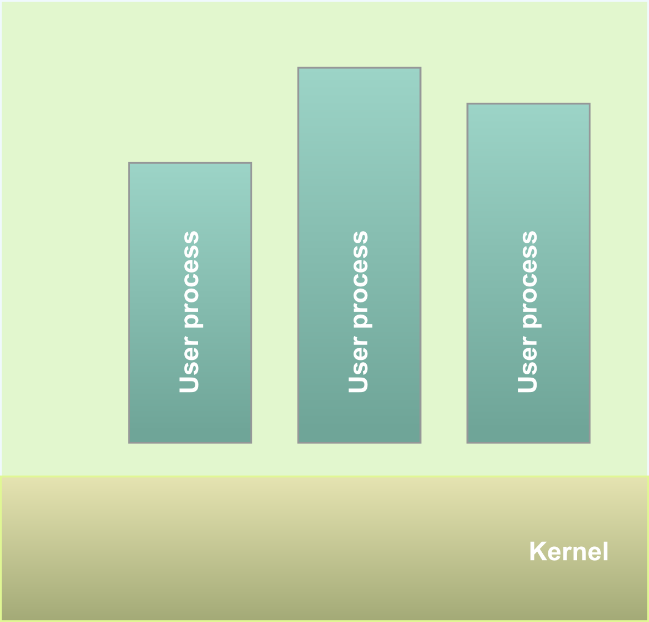
Atomicity in the local case
Temporal firewall
Selectively suspends execution and time
Provides atomicity inside the firewall
Execution control in the Linux kernel
Kernel threads
Interrupts, exceptions, IRQs
Conceals checkpoint
Time virtualization

Slide 15
Second challenge: synchronization
Lamport checkpoint
No synchronization
System is partially suspended
Preserves consistency
Logs in-flight packets
Once logged it’s impossible to remove
Unsuspended nodes
Time-outs
???
$%#!
Timeout
Notes:
ToDo: replay situation – show what’s going on during replay – on a zero delay network the packet has to wait for replay log
- After checkpoint new packets wait for replay to complete
- Experience delays

Slide 16
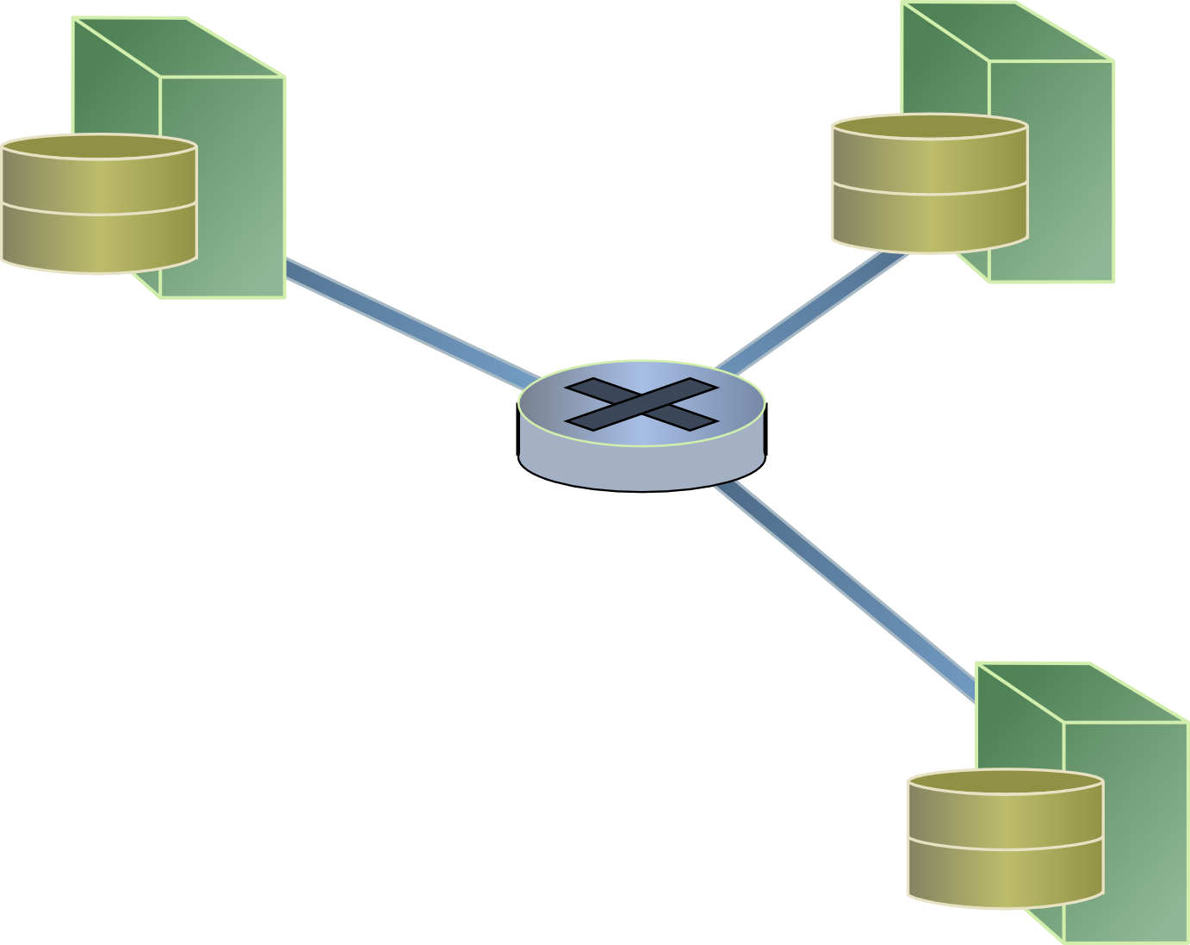
Synchronized checkpoint
Synchronize clocks across the system
Schedule checkpoint
Checkpoint all nodes at once
Almost no in-flight packets

Slide 17
Bandwidth-delay product
Large number of in-flight packets
Slow links dominate the log
Faster links wait for the entire log to complete
Per-path replay?
Unavailable at Layer 2
Accurate replay engine on every node
Notes:
- Idea about accurate packet-replay engine on every node

Slide 18
Checkpoint the network core
Leverage Emulab delay nodes
Emulab links are no-delay
Link emulation done by delay nodes
Avoid replay of in-flight packets
Capture all in-flight packets in core
Checkpoint delay nodes
Notes:
ToDo: show that in emulab it’s not like that, instead there is one packet in-flight and everything else is emulated by the dummynet

Slide 19
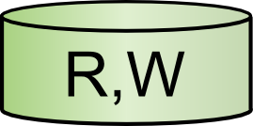
Efficient branching storage
To be practical stateful swap-out has to be fast
Mostly read-only FS
Shared across nodes and experiments
Deltas accumulate across swap-outs
Based on LVM
Many optimizations
Notes:
Copy-on-write as a redo log
Linear addressing
Free block elimination
Read before write elimination

Slide 20
Evaluation

Slide 21
Evaluation plan
Transparency of the checkpoint
Measurable metrics
Time virtualization
CPU allocation
Network parameters

Slide 22
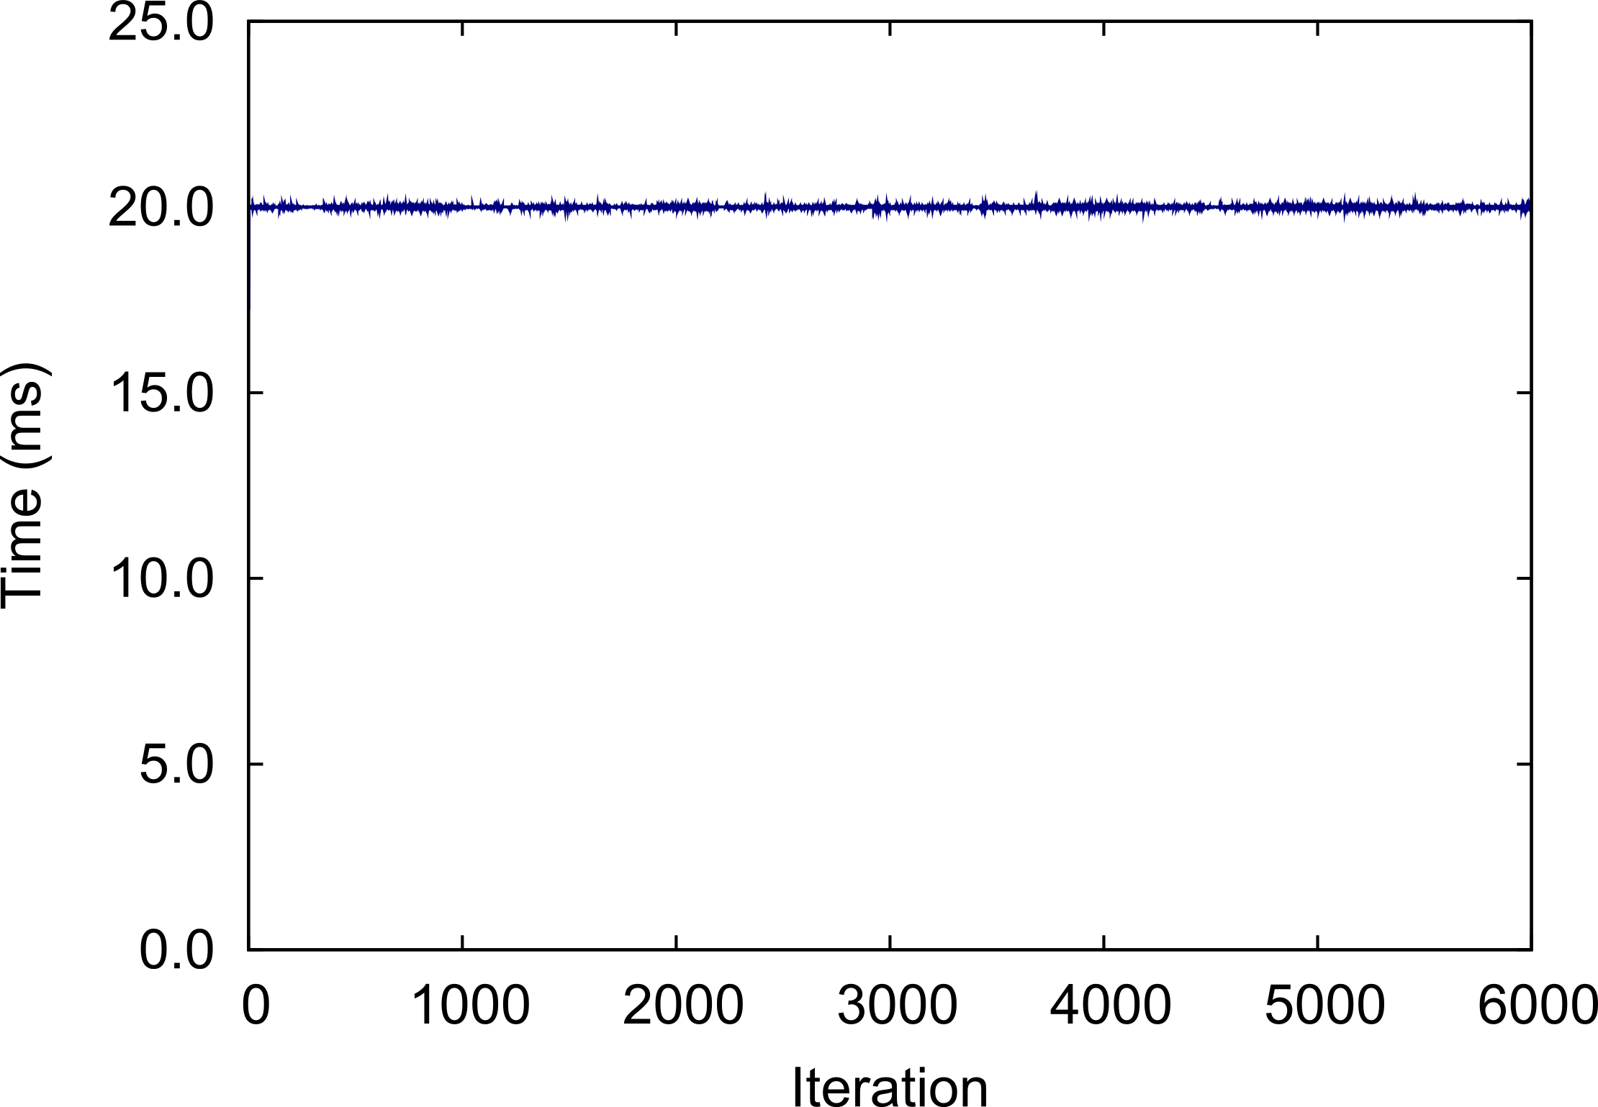
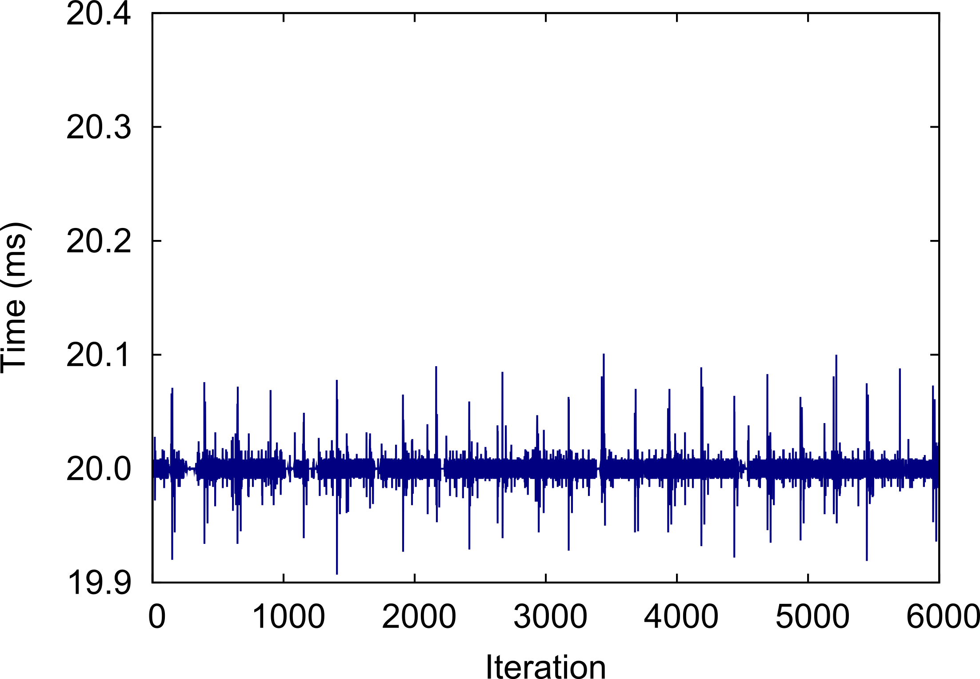
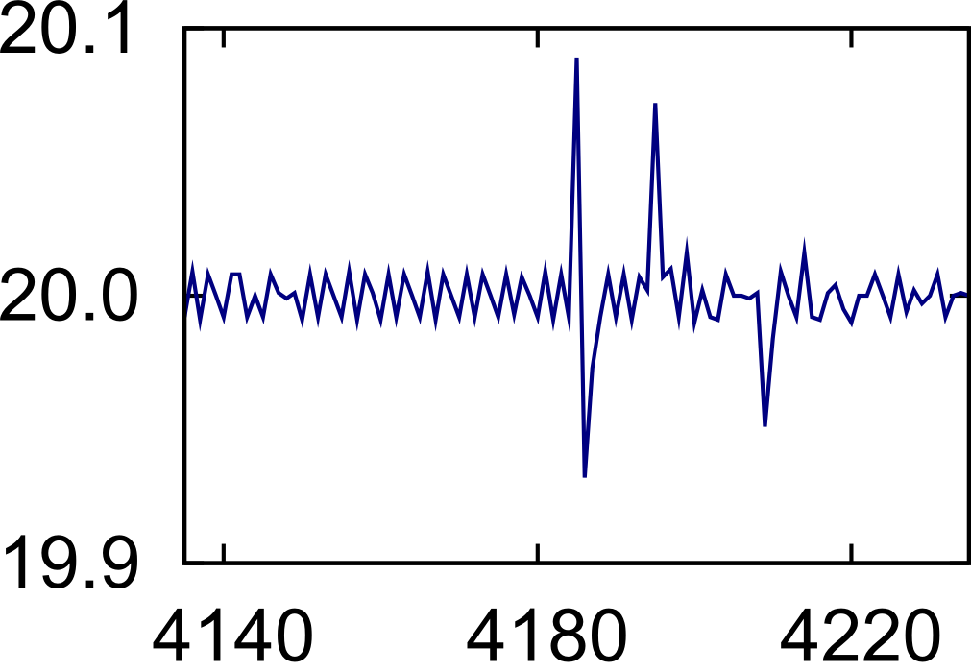
Time virtualization
Timer accuracy is 28 μsec
Checkpoint every 5 sec
(24 checkpoints)
do {
usleep(10 ms)
gettimeofday()
} while ()
sleep + overhead = 20 ms
Checkpoint adds ±80 μsec error
Notes:
Inner plot:
- 100 iteration interval around a single checkpoint
- during normal non-checkpointed operation the timer is accurate for up to 28 usec
- checkpoint introduces a +- 80 usec error

Slide 23
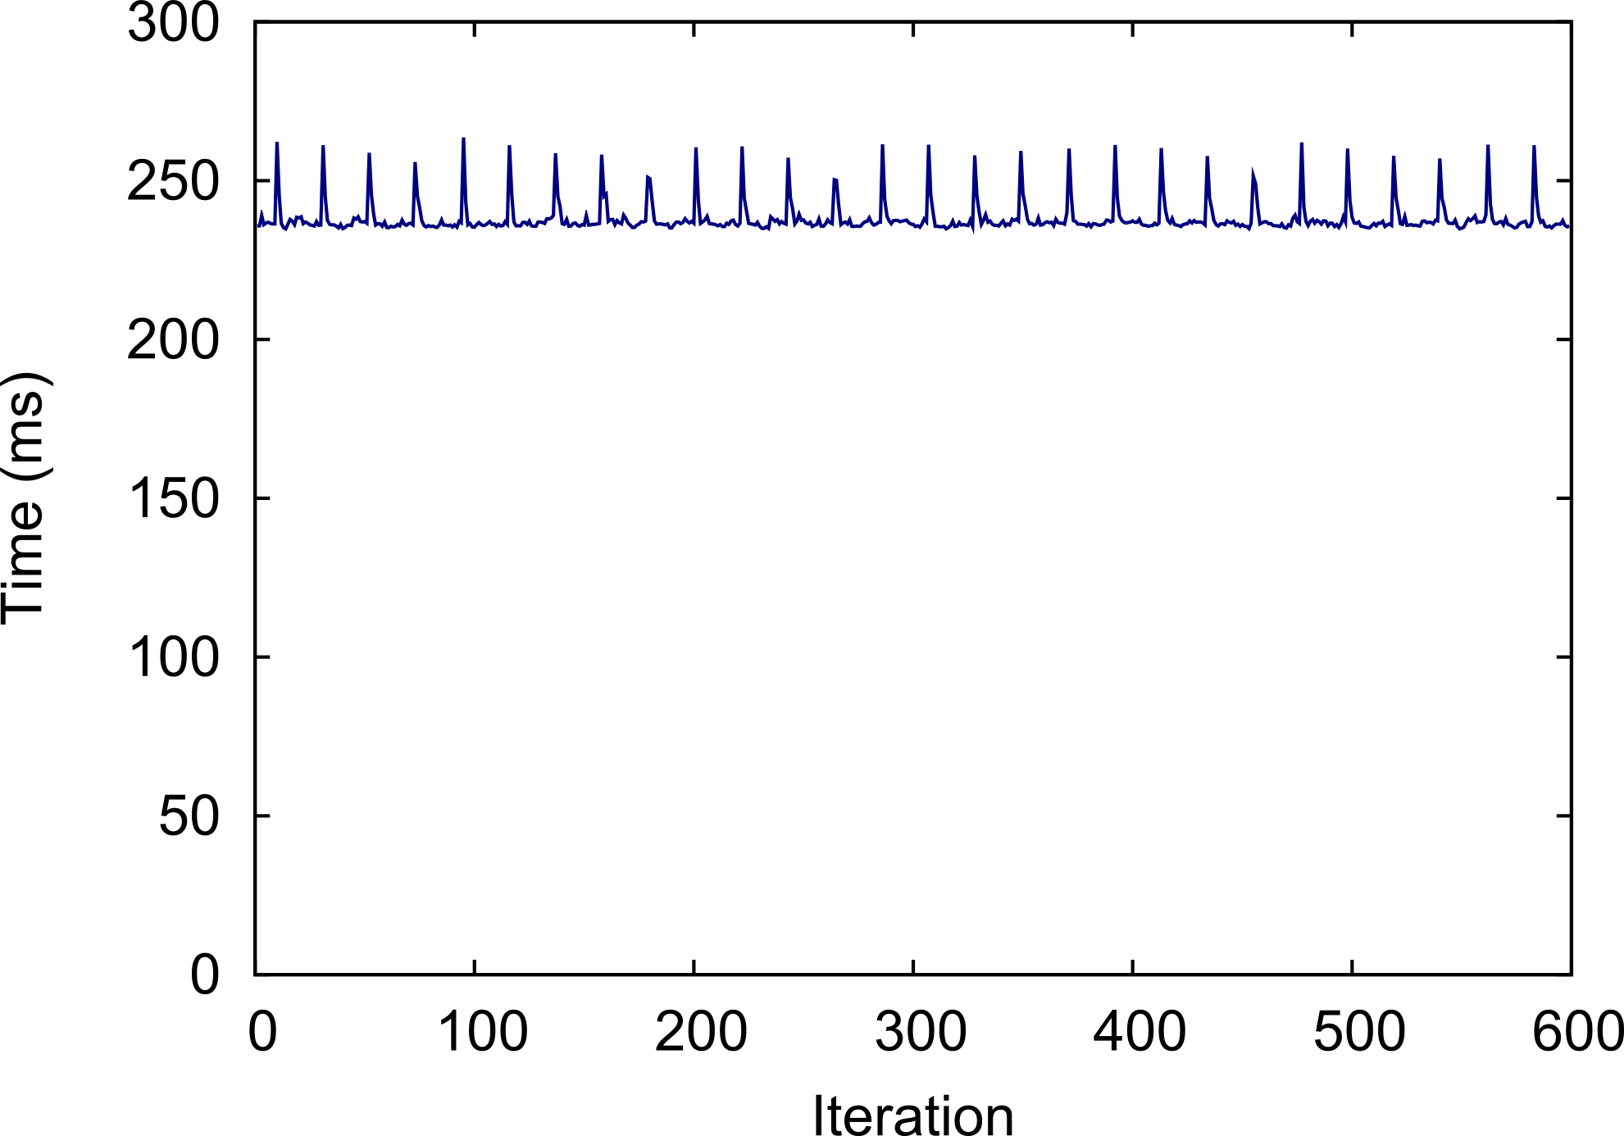
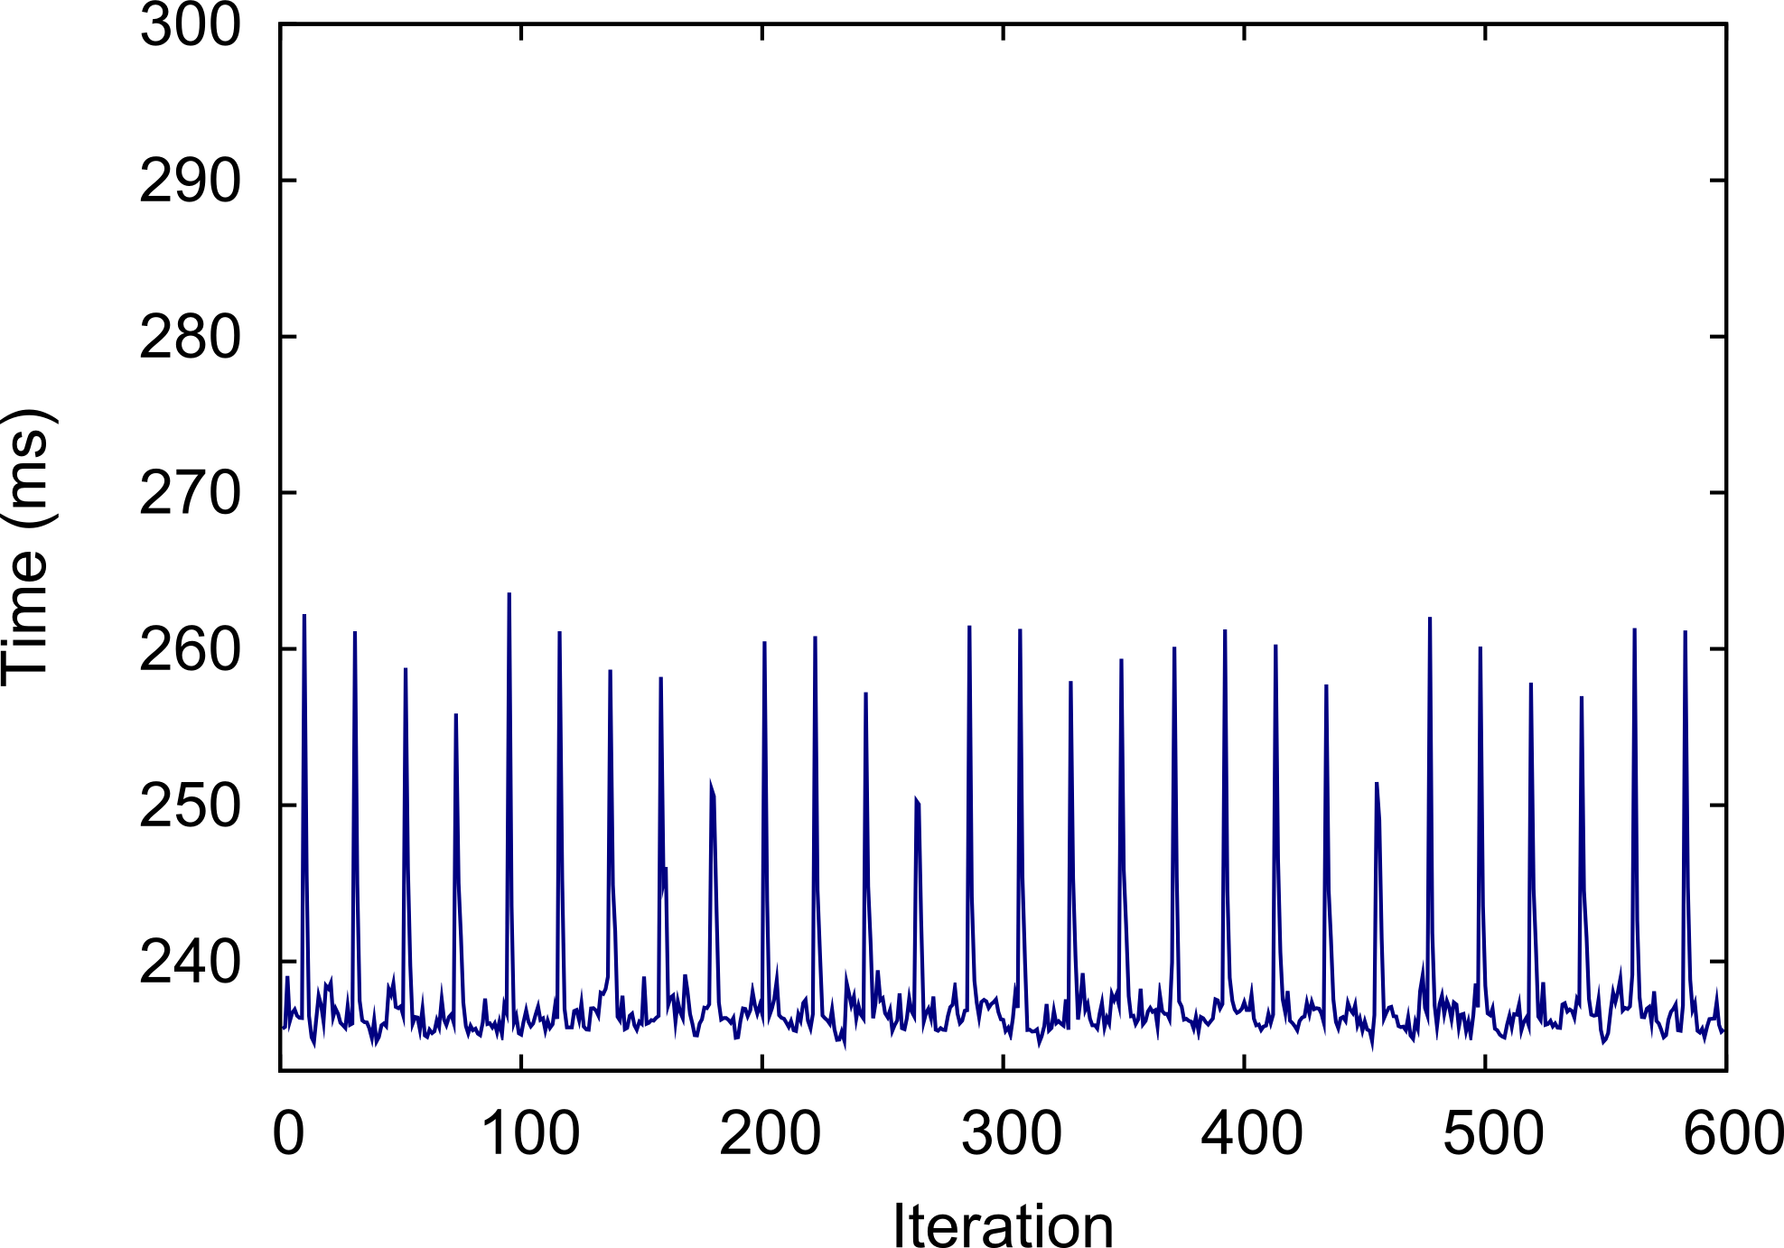
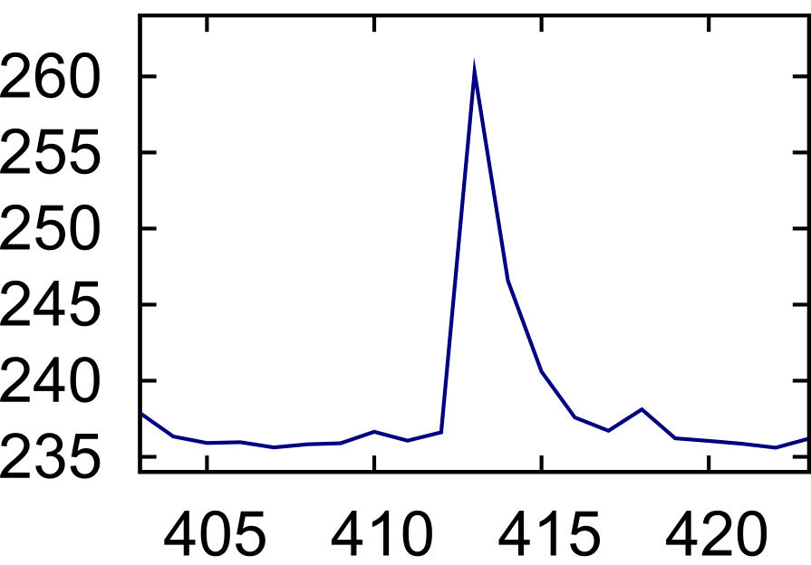
CPU allocation
Checkpoint adds 27 ms error
Normally within 9 ms of average
Checkpoint every 5 sec
(29 checkpoints)
do {
stress_cpu()
gettimeofday()
} while()
stress + overhead = 236.6 ms
ls /root – 7ms overhead
xm list – 130 ms
Notes:
Idea: we’ve experimented with different background workloads

Slide 24
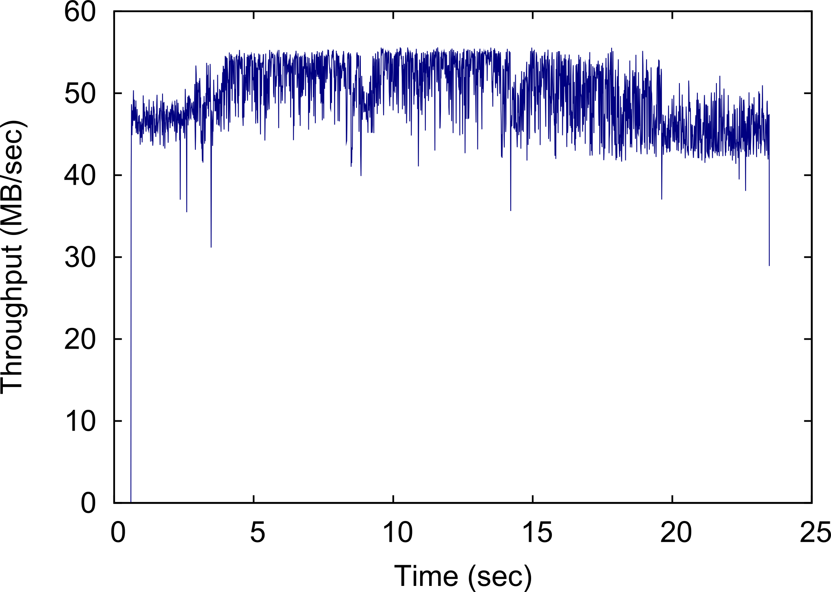
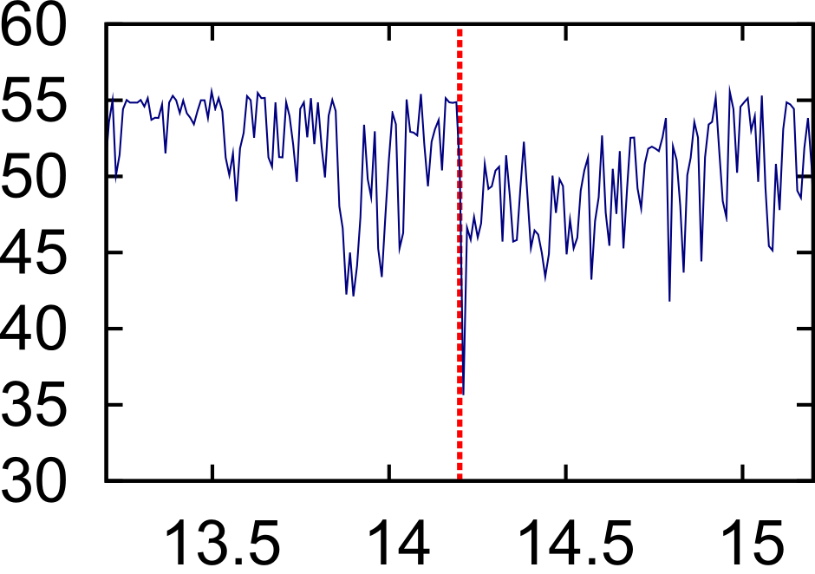
Network transparency: iperf
Throughput drop is due to background activity
Checkpoint every 5 sec
(4 checkpoints)
- 1Gbps, 0 delay network,
iperf between two VMs
tcpdump inside one of VMs
averaging over 0.5 ms
Average inter-packet time: 18 μsec
Checkpoint adds: 330 -- 5801 μsec
No TCP window change
No packet drops

Slide 25
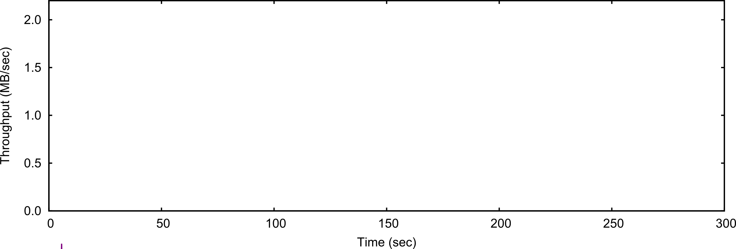
Network transparency: BitTorrent
Checkpoint every 5 sec
(20 checkpoints)
100Mbps, low delay
1BT server + 3 clients
3GB file
Checkpoint preserves average throughput
Notes:
Wait for 70 seconds and let run for 100 sec after the checkpoint

Slide 26
Conclusions
Transparent distributed checkpoint
Precise research tool
Fidelity of distributed system analysis
Temporal firewall
General mechanism to change perception of time for the system
Conceal various external events
Future work is time-travel

Slide 27
Thank you
aburtsev@flux.utah.edu

Slide 28
Backup

Slide 29
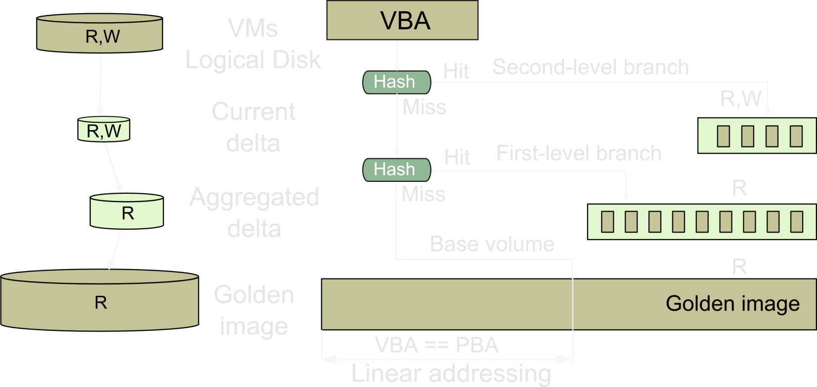
Branching storage
Copy-on-write as a redo log
Linear addressing
Free block elimination
Read before write elimination

Slide 30
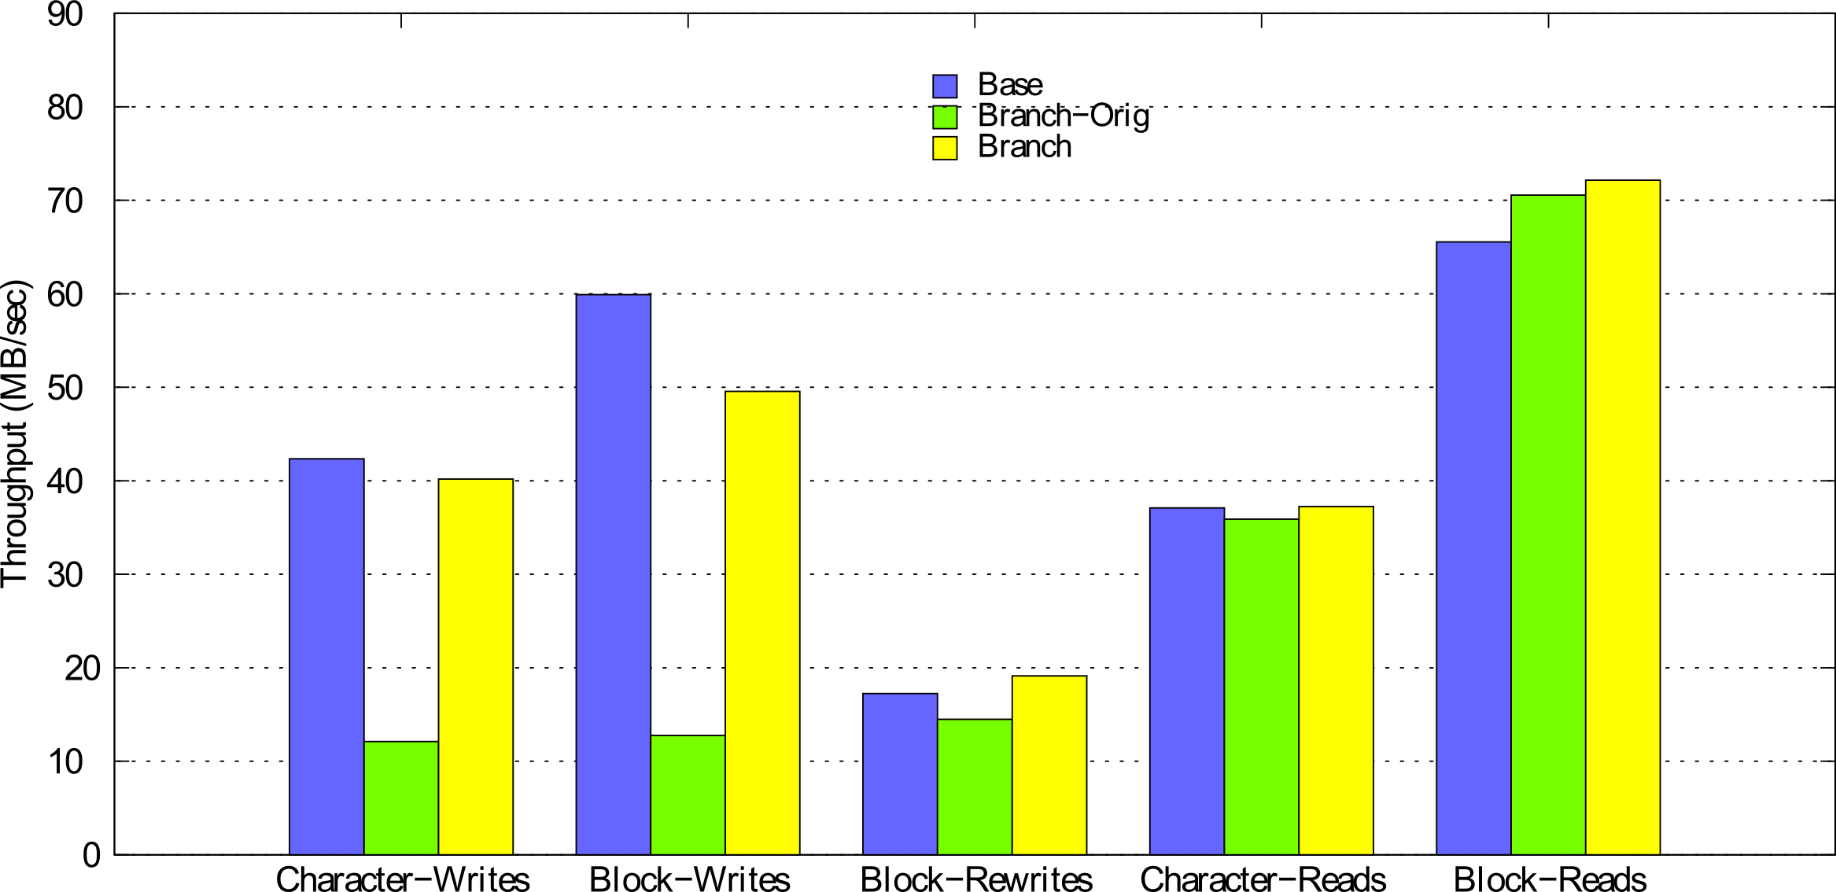
Branching storage
Notes:
ToDo: why block reads are faster?

