Slide 1
Windows Azure Internals: Opportunities and Challenges of a Cloud Operating System
Brad Calder
Corporate Vice President
Windows Azure
Microsoft

Slide 2
Agenda
Promise of the Cloud
  What a Cloud Provides
Opportunities and Challenges
  Cloud App Modeling
  Cloud Fabric
  Cloud Storage

Slide 3
Promise of the Cloud

Slide 4
The Cloud Vision
On-Demand resources
Elastically scale out and in
Available anywhere at anytime
Unlock insights from any data
Focus on application logic
Seamless experience across cloud and devices
Devices
ONE
Consistent
Platform
On-
Premises
Cloud
Map to Gartner US slide

Slide 5

Master Chief meets Windows Azure

Slide 6

Halo before the Cloud
All I wanted is to build/run a service ☹
Find Hosting location
How much space do I need? How do I grow? Redundancy? Security? Local support? Local regulations? Taxes?...
Hardware
Buy servers – Which type? Where from?
How many? What kind of support plan? Spare parts? Replacements? How do I add capacity to running service? Network gear? Storage? …
Software
Which OS? Security patches? Deploying and upgrading software? Patching firmware? Load balancing? Storage? …
Support
Support for all of the above? How much should I Invest?
Building a service!
Update Clients
A/B Testing
Stats, &
Presence
Multiplayer Lobby
Cheat & Ban

Slide 7
Halo 4 on Windows Azure
Built over 40 applications that leverages Orleans runtime
Allowed Halo to focus on their application logic instead of infrastructure
Challenges
Title File
Admim
Emblem
Video Ingestion
Personalize
QoS
Register Client
ContentMang
System
Profile
UGC
Cheat & Ban
Search
XBOX Live Proxy
BI
Stats
Lobby
Presence
Windows Azure

Slide 8
Game Traffic
Launch predictions are often wrong
  Not enough capacity leads to
  bad user experience and potentially outages
  Too much capacity can waste a significant amount of money
Cloud Elasticity is key
  For cost and user experience
  Able to scale out and in to tightly ride the demand curve
Traffic can be spiky
Time in Days

Slide 9
Provisioning Resources before the Cloud
Demand
Provision
Overprovisioned
Underprovisioned
Problem: Significant wasted costs vs outage/risk bad user experience
Under Provisioning
(catching up with demand)
Over Provisioning
Resource
Demand
Resource
Provision
Time
Time

Slide 10
Elasticity – Provisioning in the Cloud
Demand
Provision
Cloud provides on-demand, scale out and in,
compute, storage and network resources
Provisioning Benefit: Reduced Costs and Improved User Experience
How does the Cloud support this? Scale
Overprovisioned
Underprovisioned
Self Provisioning
Cloud Provisioning
Resource
Resource
Time
Time

Slide 11
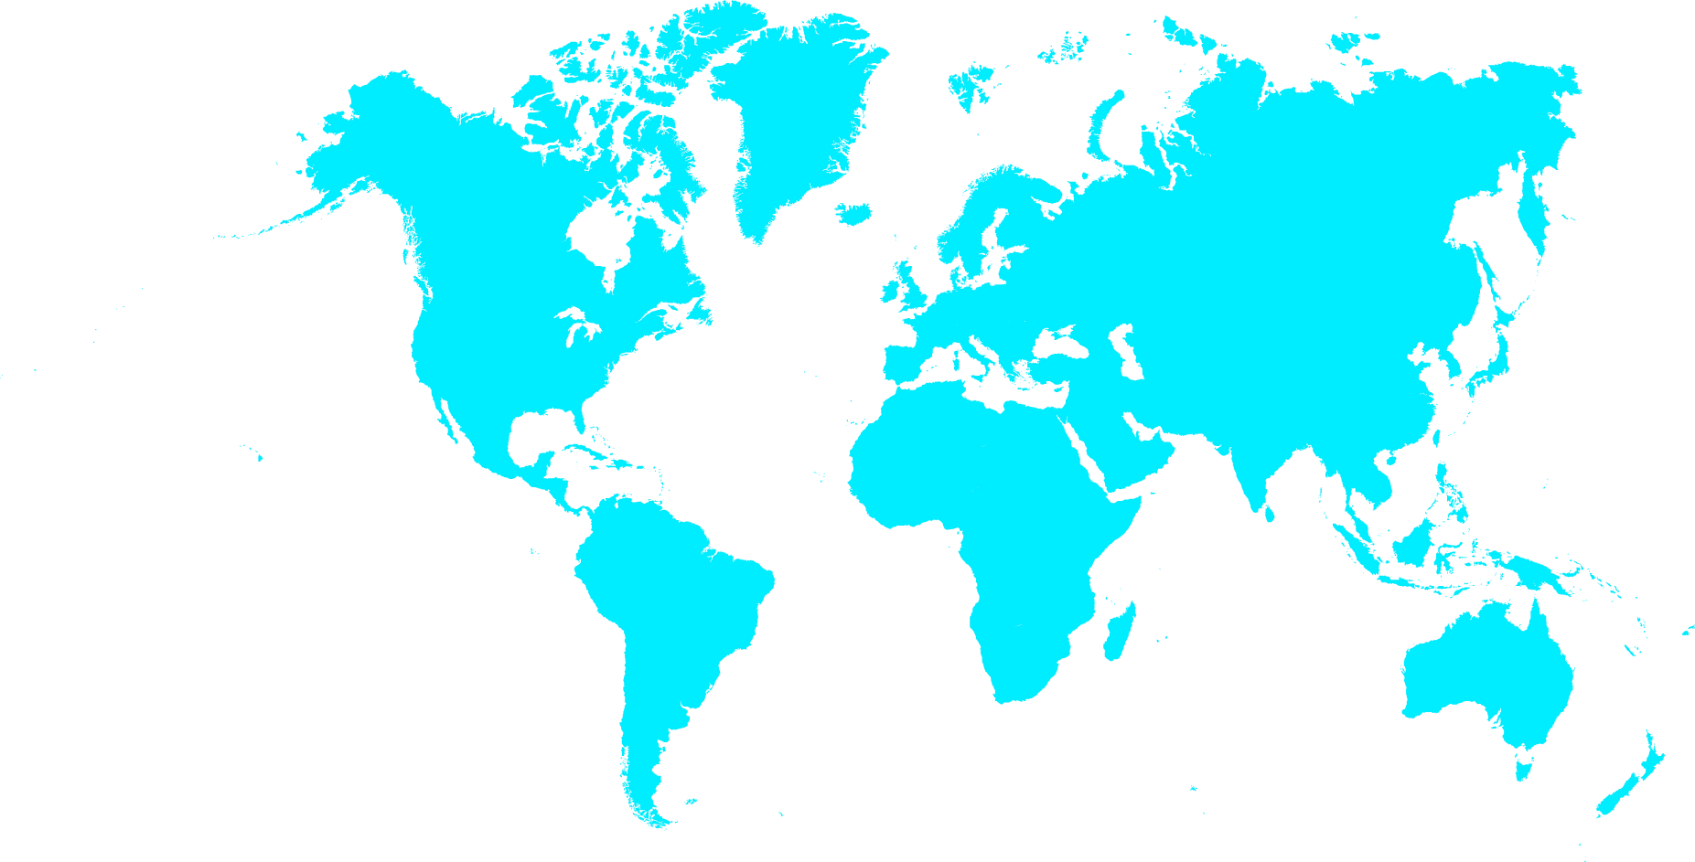
Windows Azure’s Scale
Over 250,000 External Customers
  Adding 1,000+ new customers a day
  Capacity demand doubling every
  9 months
Microsoft Services on Azure:
Windows Azure
Cloud
SkyDrive

Slide 12
What a Cloud Provides

Slide 13
Windows Azure’s
Global Footprint

Slide 14
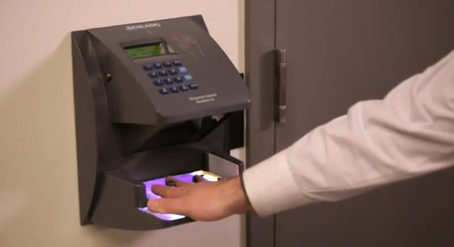
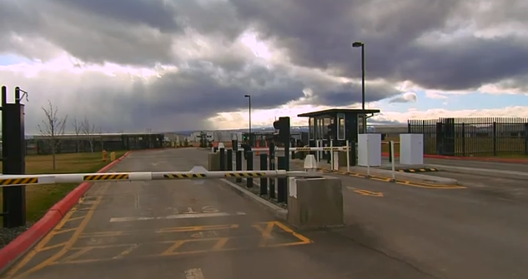
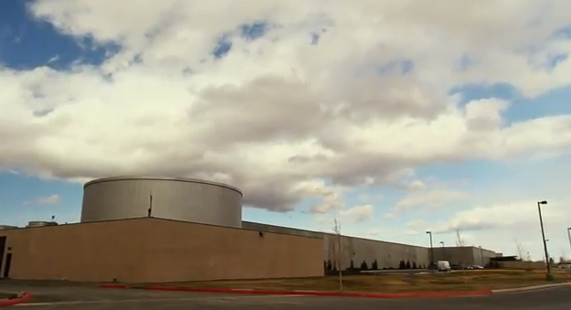
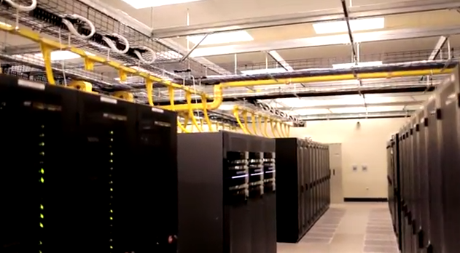

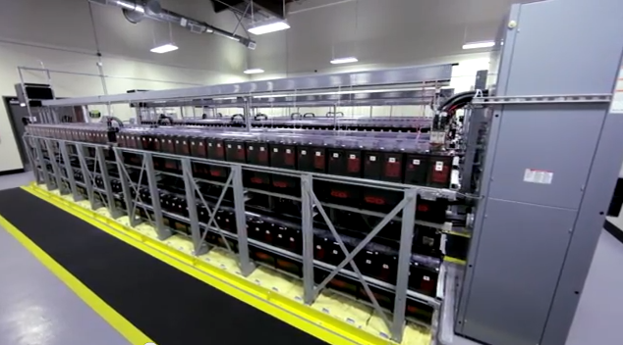
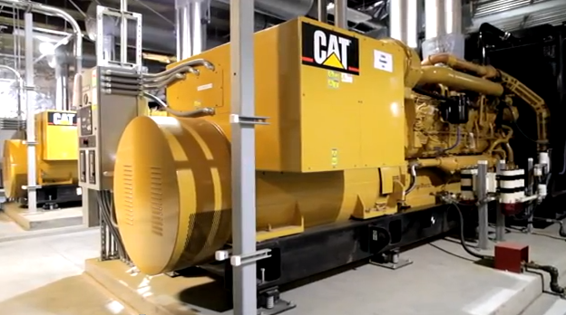
Datacenters
Datacenter Security
Power Redundancy

Slide 15
Service Glue –
What a Cloud Provides Under the Covers
App business logic
…
Overprovision for blended peak traffic
Add compute/storage capacity on the fly
OS patches and Deploying/Upgrading App
Metering and billing infrastructure
Service “glue”
Monitoring and alerting infrastructure
Reliable/Secure computation and storage
Respond to hardware failures
Buy and provision hardware
Datacenter (Power, Cooling, Internet)

Slide 16














Building Blocks Provided by Windows Azure to Make it Easier to Build Applications
^{App}
^{services}
  Building modern apps that connect
  services with devices
cloud services
caching
identity
service bus
media
mobile services
web sites
BizTalk Services
hpc
analytics
  Managing data
^{Data}
^{services}
SQL database
HDInsight
Table
Blob storage
^{Infrastructure}
^{services}
  IT infrastructure
Virtual machines
Virtual network
VPN
Traffic manager
CDN

Slide 17
Cloud App Modeling

Slide 18


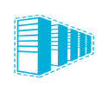

Cloud App Modeling
^{App}
^{services}
Cloud App Model
compute services
caching
identity
service bus
media
mobile services
web sites
BizTalk Services
hpc
analytics
Cloud Application
^{Data}
^{services}
SQL database
HDInsight
Table
Blob storage
^{Infrastructure}
^{services}
Virtual machines
Virtual network
VPN
Traffic manager
CDN
Application modeling and composition

Slide 19
Cloud Application Model Concepts
Fault
Domain
Resources
  Identify building blocks used in the service
  App’s service code to be run on VMs
Deployment
  Choose number of Fault Domains (FD)
    Unit of failure based on data center topology
      E.g. top-of-rack switch on a rack of machines
    Spread VMs out across FDs to avoid single points of
    physical failure
  Choose number of Upgrade Domains (UD)
    Percentage of your app you will take offline for an upgrade
    at a time
Configuration
  Specify number of instances
  Set the desired configurations for resources
  Allows dynamic changes to configuration
Upgrade
Domain
Cloud Application
web sites
compute services
media
SQL database
Blob storage
Virtual machines
Virtual network

Slide 20

Cloud Application Model Concepts (2)
Contracts + topology across components
  Enforce specified contracts and control access across components
  Provides resource discoverability and change notification
Integrated identity/auth across components
  Access control across component endpoints
  Role based access control
Allows management of quotas, monitoring, alerts
Dynamic scaling
  Scale in/out: vary number of vm instances
Cloud Application
web sites
compute services
media
SQL database
Blob storage
Virtual machines
Virtual network
Virtual machines
Virtual machines

Slide 21
Windows Azure App Model
A Windows Azure application consists of a Model with
  Definition information
  Configuration information
  At least one “role”
A role is the scaling boundary within an app
  Roles are like DLLs in your “cloud application”
    Collection of code that runs in its own virtual machine
    with an entry point that WA knows how to invoke
Virtual machine is scale unit
  Role code runs in a virtual machine
  Role scales by varying the number of virtual machines running that role code
Dependencies captured in Model
  Dependency across roles and resources
  Connections and contracts among roles and resources

Slide 22
An Example: Multi-Tier Cloud App
Example Photo Processing Service with 2 Roles
  Network Load balancer, Virtual IP
  Front End Stateless Web Role: take requests from users
  Middle-tier Worker Role: process the order
  Backend storage: Azure Storage, SQL Azure
  Dynamic scaling # of role instances by scaling # of VMs
Windows
Azure
Storage,
SQL Azure
Front-End
Middle-Tier
Front-End
Front-End
Middle-Tier
Load Balancer
Middle-Tier
HTTP/HTTPS
Middle-Tier
Cloud Application

Slide 23
App Model Example
App Model
Role: Middle-Tier
MT Code Package
Definition
Type: Worker
VM Size: Large
Endpoints: Internal-1
Configuration
Instances: 5
Update Domains: 4
Fault Domains: 3
Auto Scaling Rules
Role (VM): scaling boundary
  Code package to run on a VM
  Definition
    Name, type, VM Size, endpoints, etc
  Configuration
    Instance, UD, FD, Auto Scaling, etc
Connections and contracts
  Who can talk to whom
  Connection strings to other building block resources
Windows
Azure
Storage,
SQL Azure
Role: Front-End
FE Code Package
Definition
Type: Web
VM Size: Medium
Endpoints: External-1
Configuration
Instances: 3
Update Domains: 3
Fault Domains: 3
Auto Scaling Rules
Front-End
Middle-Tier
Front-End
Middle-Tier
Load Balancer
Front-End
Middle-Tier
HTTP/
HTTPS
Middle-Tier
Cloud Application
Network Binding:
Middle-Tier.Internal-1
DBConnection:[photo]
Resource: SQLAzure
DBConnectionString: [@photo]

Slide 24
Cloud Fabric

Slide 25
The Fabric Controller (FC)
Fabric Controller translates the Cloud Application Model into
  A running service
  Keeps the service running
  Provides upgrade and management capabilities
  and more
The “kernel” of the cloud operating system
  Programs, manages and owns all of the datacenter hardware
  Manages Windows Azure provided building block services
  Manages all customer applications
Inputs:
  Description of the hardware and network resources it will control
  App model and binaries for cloud applications

Slide 26
Windows Azure Fabric Controller
Fabric
Agent
VM
VM
VM
WS Hypervisor
Hardware control
Load-balancers
Software control
Switches
Highly-available
Fabric Controller

Slide 27
Cloud App Model Deployment Steps by FC
Allocation across fault and update domains
Process App model files
  Determine resource requirements
  Create role images
Allocate compute and network resources
  Across separate fault and upgrade domains
Prepare servers assigned to run the roles
  Place role images on servers
  Create virtual machines
  Start virtual machines and roles
Configure networking
  Dynamic IP addresses (DIPs) assigned to VMs
  Virtual IP addresses (VIPs) + ports allocated and mapped to sets of DIPs
  Program load balancers to allow traffic to external endpoints
  Configure packet filter for VM to VM traffic within application
Load-balancers

Slide 28
App Model
Windows
Azure
Storage,
SQL Azure
Role: Front-End
Definition
Type: Web
VM Size: Medium
Endpoints: External-1
Configuration
Instances: 3
Update Domains: 3
Fault Domains: 3
Auto Scaling Rules
Role: Middle-Tier
Definition
Type: Worker
VM Size: Large
Endpoints: Internal-1
Configuration
Instances: 5
Update Domains: 4
Fault Domains: 3
Auto Scaling Rules
Front-End
Middle-Tier
Front-End
Middle-Tier
Load Balancer
Front-End
Middle-Tier
HTTP/
HTTPS
Middle-Tier
Cloud Application
Network Binding:
Middle-Tier.Internal-1
DBConnection:[photo]
Resource: SQLAzureDB
DBConnectionString: [@photo]

Slide 29
FC Deploying an App
Web Role
Front-End Role
Count: 3
Fault Domains: 3
Upgrade Domains: 3
Size: Medium
Worker Role
Middle-Tier Role
Count: 5
Fault Domains: 3
Upgrade Domains: 4
Size: Large
www.mycloudapp.net
www.mycloudapp.net
Load
Balancer
10.100.0.36
10.100.0.113
10.100.0.122
Upgrade domain
Filled Cores
Empty Cores
Compute
Server
Fault domain

Slide 30
FC Automated Management
Windows Azure FC monitors the health of roles
  FC Agent on the server detects if a role dies
    Restart the role to bring it back to a healthy state
If a failed server or FD can’t be recovered,
FC starts new role instances on available VMs
  A suitable replacement location is found based on FD and UD requirements
  Existing role instances are notified of the configuration change

Slide 31
App Resource Allocation Goals
FC Primary Goal: Allocate app roles to available resources while satisfying all hard constraints
  HW requirements based on size of VM chosen:
    CPU, Memory, Storage, Network
  Fault domains, update domains
FC Secondary Goal: Satisfy soft constraints
  Try to not fragment servers
    E.g., so that large VMs can’t fit on them

Slide 32
Fabric Scheduling Opportunities
FC scheduling across all apps is a complex scheduling problem trying to minimize costs, while meeting all customer app constraints
Opportunities for improvements and additional features
  Advanced rules for specifying when to scale out/in
    Some resources need to be scaled together and what ratios
  Allow scaling up and down in terms of VM size to automatically figure out the size of VM to use
    Currently app model is specific about the resources needed for each role’s VM: CPU, Mem, network, storage, etc
    But customers don’t have a good understanding of workload behavior
  Allow for better managing of resources to reduce app costs
    Deadlines
    Gang scheduling
  and more…

Slide 33
Cloud App Modeling Opportunities
How to express advanced scheduling features (autoscaling, deadlines, gang scheduling, etc)
Current systems allows developers to define environments in which applications live
  Need to continue to abstract away infrastructure and focus on application logic
    Allow devs to focus on their specific problem domain and less on how to configure, deploy, and manage their service
  Richer runtimes and programming languages
    See “Orleans” in ACM Symposium on Cloud Computing 2011 by Microsoft Research

Slide 34
Cloud Storage

Slide 35




Data Storage Options on Windows Azure
SQL Database
(Relational)
Table Storage
(NoSQL
Key/Attribute Store)
Blob Storage
(unstructured files)
SQL Server, MySQL,
Postgress, RavenDB, MongoDB, CouchDB, neo4j, Redis, Riak, etc.
Platform as a Service
(managed services)
Infrastructure as a Service
(virtual machines)

Slide 36
Storage topics
Understanding and Optimizing Costs
  Need to continually optimize costs at scale
Location Durability
  Durability vs Performance vs Consistency

Slide 37
Understanding and Optimizing COGS
Hosting Cost
  Data Center, Power, Cooling, Operations, Reserving/Occupying Space, etc
Continuous hardware design
  New hardware design (SKU) at least every year (hardware lasts for 3-4 years)
  Track and take advantage of new technology
Reducing WIP (Work in Progress)
  Time from order arriving on Dock to the time it is fully used
  Time to Build, Time to Live, Time to Fill
  Need to incrementally and efficiently add capacity
Multi-tenancy
  Blend different workloads and customers to reduce COGS
    Keeps overprovisioning overheads low due to economies of scale
    Fully utilize resources by blending different workloads (e.g., Disk GBs vs IOs)
  Customers needs consistent performance
    Deal with spikes and varying workloads, deal with background jobs, and seamlessly load balance hot spots away
    Appropriately throttle and provide isolation among customers

Slide 38
Reduce Costs using Erasure Coding
At Exabytes+ the savings are significant
3 Replica
Standard EC
LRC
3x
50%
Storage
Overhead
1.5x
14%
1.29x
    “Erasure Coding in Windows Azure Storage”, USENIX Annual Technical Conference, June 2012
    https://www.usenix.org/conference/usenixfederatedconferencesweek/erasure-coding-windows-azure-storage

Slide 39
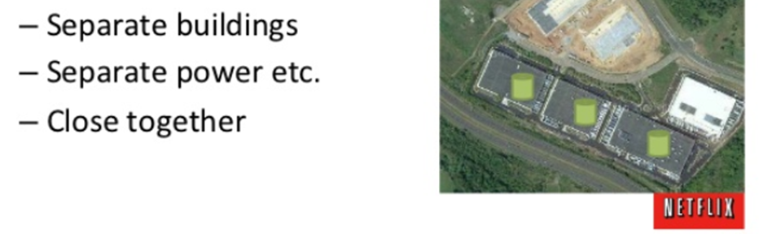
Location Durability
How “far apart” should your data be replicated?
Some data is fine to be kept within a single “region”
(replicas are kept within a mile(s) of each other)
  From a 2011 Netflix presentation (http://www.slideshare.net/adrianco/migrating-netflix-from-oracle-to-global-Cassandra):
Whereas other customers require replicas to be kept
100s of miles apart from each other for DR (disaster recovery)
  Ability to recover from major disasters including
  natural and man made disasters

Slide 40


Windows Azure Storage
Two Types of Durability Offered
Local Redundant Storage
3 replicas within region
Local Redundant Storage
  3 copies (or EC’d) within region
Geo Redundant Storage
  6 copies (or EC’d) across
  2 regions 100s miles apart
  Commit quickly within
  primary region
  Async geo-replication to secondary region
  Allow customers read access to secondary region
Commit quickly within region
N. Central Region
Async geo-replication
S. Central Region

Slide 41
Decisions about State during App Design
Trade off Durability vs Performance vs Consistency
What state to keep within a single regional only?
  Data that can be regenerated, intermediate data, logs, …
  Benefit is lower costs and higher BW for processing the data
Then for state that needs to be Geo Redundant for higher durability
  What state to commit quickly in primary region and
  then asynchronously to a secondary region?
    Data that needs consistent low latencies
    Large data updates (need flexibility when consuming cross regional bandwidth)
  What state must be committed across multiple regions before the update is deemed successful?
    Credentials, critical service metadata, …

Slide 42
Coordinating State Across Components
Many applications use several data services
(e.g., Blobs, NoSQL Tables, SQL, etc)
Challenges
  Coordinated consistent view of the data across data services
    Point-in-Time Recovery
    Reasoning about a consistent view at massive scale and across geo redundancy

Slide 43
Summary

Slide 44
Summary
Promise of the Cloud
  Cloud abstracts away infrastructure
    to allow developers to focus on application logic
  Cloud provides building block services
    to ease and speed app development
  Cloud provides Elasticity
    to reduce costs and improve user experience
Cloud is in its infancy
  Cloud demand is more than doubling each year
  Just starting to scratch the surface of its potential
Many areas ripe for research
  Cloud Application Modeling
  Fabric Scheduling of Cloud Applications
  Continually Optimizing Costs
  Location Durability
  and many more

Slide 45
More Information on Windows Azure
http://www.windowsazure.com/
Free month of Windows Azure
  http://www.windowsazure.com/en-us/pricing/free-trial/
Windows Azure Publications
  “Windows Azure Storage: A Highly Available Cloud Storage Service with Strong Consistency”, ACM Symposium on Operating System Principals (SOSP), Oct. 2011
  http://sigops.org/sosp/sosp11/current/2011-Cascais/printable/11-calder.pdf
    “Erasure Coding in Windows Azure Storage”, USENIX Annual Technical Conference, June 2012
    https://www.usenix.org/conference/usenixfederatedconferencesweek/erasure-coding-windows-azure-storage
  We are hiring full-time and interns – bcalder@microsoft.com

